Slide 1


Change Management
mSCOA
Presented by: xxx
Date
mSCOA

Slide 2

“It’s not so much that we’re afraid of change, or so in love with the old ways, but it’s the place in between that we fear… it’s like being between trapezes. It’s Linus when his blanket is in the dryer. There’s nothing to hold on to.”
- M. Ferguson

Slide 3

Organizational Issues
The Nature of Change
Leading Others Through Change

Slide 4
Organizational Issues
The Nature of Change
Leading Others Through Change

Slide 5


Organizational Issues
What is “Change Management”?
Key characteristics of an organization going through change
Pre-requisites for change
Effective change leaders
Why apply change management?

Slide 6
What is “Change Management”?
The process, tools and techniques to manage the people side of change, to achieve the required business results.
Change management drives project success by supporting individual transitions required by organizational projects and initiatives

Slide 7
Key characteristics of an
organization going through change
Willingness to make change
Identifies problems quickly
  Internal and external
Trust
  Open to feedback
  Implements solutions rapidly
Willingness to learn
Focus on innovation
  Upward communication
Enthusiasm
Long-term focus
Skill development
Notes:
All important in the implementation of mSCOA – discuss this. Especially the willingness for change, willing to learn new things as the change occurs and open to feedback.

Slide 8
Pre-requisites for change
Vision: Develop, articulate and communicate a shared vision of the desired change
Need: A compelling need has been developed and is shared
Means: The practical means to achieve vision: planned, developed and implemented
Rewards: Aligned to encourage appropriate behavior compatible with vision and change
Feedback: Given frequently
Notes:
Vision to be communicated by the implementation and steering committee – to make employees want to adopt the same vision
Need for mSCOA – for accurate timely reporting, increased assistance by NT and PT as they will be able to analyse data more efficiently and effectively, lastly, mSCOA is not optional (reduce risk of not receiving equitable share as a result of not being mSCOA compliant)
Means – through proper budgeting, proper analysis of the current system and the transversal contract, financial means should be achieved. Employees in the municipality have the competence to carry out the mSCOA implementation but will in most cases have to work around time constraints taking in to consideration responsibilities outside of the scope of mSCOA
Reward – the reward will come with more efficient processes and reporting thus improved service delivery, freeing up time thus reducing overtime to get reporting done and creating a better work environment – improved cash flow as a result of improved service delivery and monitoring will increases employee morale
Feedback – so that employees know what has happened, what is still to come and where in the process of change they currently are to avoid communication gaps

Slide 9
Effective change leaders
Embrace change when it’s needed
Develop a vision for change
Communicate effectively
Shake things up by challenging status quo and encouraging others to do the same
Stay Actively Involved by walking the walk and being visible about it
Direct, Review Implementation of change - continued participation - never done attitude - be in position to notice and coach
Notes:
Qualities of an effective change leader – mSCOA steering and implementation committees are effectively these change leaders

Slide 10
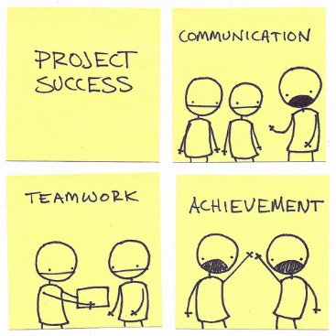
Why apply change management?
Increase probability of project success
Manage employee resistance to change
Build change competency in the organization

Slide 11
Organizational Issues
The Nature of Change
Leading Others Through Change

Slide 12

Change in Government is not new –
change is constant…
its how you approach it that makes all the difference

Slide 13
The Nature of Change
Exercise
What to expect from change
What will happen if the ‘people side’ of change is not managed?
States of change
Psychology of change
Changing the head
Changing the heart
Changing the hand

Slide 14

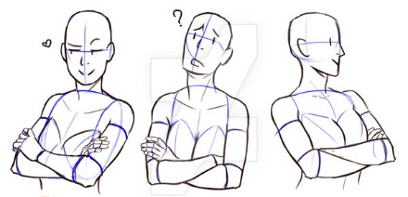
Exercises
1: Crossed Arms
2: Seat Swop
Notes:
Change Game 1: Cross Your Arms
Duration: 5 minutes
Number of participants: unlimited
Materials required: none
Description/Process: For facilitators facing a large group and not a lot of time, this exercise really gets the point of change across. After the introduction of the “change” subject, ask the audience to “cross their arms.” My operational definition of “crossed” is folding their arms together, as if they were bored or waiting for something. Once they have completed this task, ask them to “fold their arms the other way,” reversed of what they just performed. I guarantee that 90 percent of the class will struggle with it.
Discussion Questions
How did it feel when you were asked to cross your arms the other way?
Did it come naturally or did you have to stop and think about it?
Were you comfortable with doing this differently from your normal process?
What are some things that make people resistant to change?
What can you do to make it easier for people in your organization to accept the changes associated with Lean and Six Sigma?
What kind of support is necessary to maintain the changes?
Facilitator Notes
When people cross their arms, they do so naturally, without even thinking about it. When they are asked to fold them the other way they, for the most part, stop, refold their arms again and then try to figure out which arm was on top, which arm moves first and so on. Try this yourself and see. Encourage participants to consider and share their own personal emotions related to making changes.
Change Game 2: Change Your Seat
Duration: 5 to 15 minutes (depending on debrief)
Number of participants: unlimited
Materials required: none
Description/Process: This is another quick and easy game. Participants are asked to change where they are sitting so they can experience the emotions and feelings often associated with change. After the class gets situated and comfortable, the facilitator should ask participants to change seats.
Discussion Questions
How did it feel to be asked to change seats?
Did you view changing seats as an opportunity to sit with someone new or as an uncomfortable or undesirable change?
What are some things that make people resistant to change?
What can you do to make it easier for people in your organization to accept the changes associates with Lean and Six Sigma?
If participants move back to their old seating arrangements after the exercise is over, ask the following questions:
Why is it difficult to maintain changes once they are made?
What kind of support is necessary to maintain the changes?
Facilitator Notes
Encourage participants to consider and share their own personal emotions related to making changes. This is what makes the exercise powerful.

Slide 15
What to expect from change
Sense of loss, confusion
Mistrust and a “me” focus
Fear of letting go of that which led to success in the past
People hold onto & value the past
High uncertainty, low stability, high emotional stress
Perceived high levels of inconsistency
High energy — often undirected
Control becomes a major issue
Conflict increases — especially between groups
Notes:
Loss or confusion because of the new mSCOA system
Fear of letting go – especially in municipalities with clean audits if they believe mSCOA will negatively impact there audit outcome
Conflict may increase where previously budgeting was done by the budgeting department but now input is needed from each department. This affects control also.

Slide 16
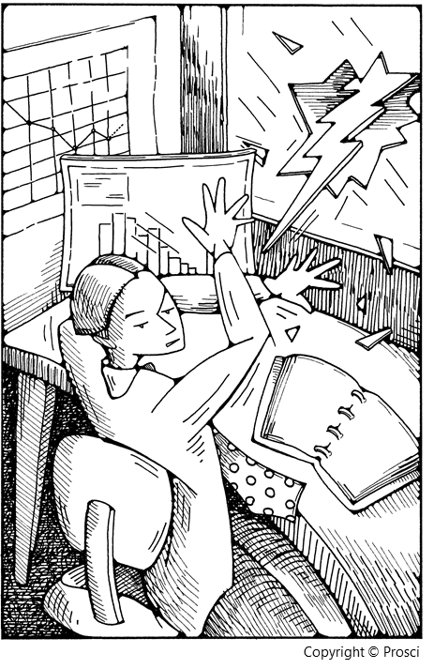
What will happen if the ‘people side’
of change is not managed?
Lower productivity
Passive resistance
Active resistance
Turnover of valued employees
Disinterest in the current or future state
Arguing about the need for change
More people taking sick days or not showing up
Changes not fully implemented
People finding work-arounds
People revert to the old way of doing things

Slide 17
States of change
Current
state
Transition
state
Future
state
How things
are done today
How to move
from current
to future
How things will
be done
tomorrow
“Coming to Grips with the Problem”
“Working through the Change”
“Attaining and Sustaining Improvement”
Notes:
Both in the organisation and per individual
All employees should understand their current state, we need to communicate and identify what the transition phase to mSCOA will entail (that should be where we are currently) and when the transition will occur, lastly we need to educate individuals on the benefits of mSCOA and why the future state is important

Slide 18
Psychology of change
Why should I change?
Mental/Reasoning
What’s in it for me?
Feelings/Emotions
Head
Heart
Hands
What should I do differently?
Physical (Body)
Notes:
In mSCOA we refer to these matters as the head, heart and hand of every individual in the mSCOA implementation.
We need to connect the head, heart and hand of every individual to ensure the success of mSCOA.
Lets look at this more closely…

Slide 19
Changing the head
  Create an understanding of mSCOA across the organisation
    Awareness sessions
      Awareness sessions within the municipality using material on NT website
    Training
      Accredited mSCOA training trough IMFO
Head

Slide 20
Changing the heart
  Can be frightening
  Guide officials from now until mSCOA becomes business as usual
  Best way to address “changing the heart”
    Constant and positive communication
      All individuals should define and implement their own solutions - create ownership of their part in mSCOA implementation
      Articulate benefits of mSCOA
      Celebrate every small victory
Heart

Slide 21
Changing the heart continued…
  Ideas for communicating mSCOA
    Posters and newsletters
    Dedicated repository where officials can find mSCOA information
    Distribute regular mSCOA information snippets via email
    Create information sessions in the municipalities and facilitate open discussions
Heart

Slide 22
Changing the hands
  mSCOA is an organisational reform and as such includes – all employees, departments and functions in the municipality
  Encourage individuals to
    Review their own business activities
    Identify changes effected by mSCOA
    Get involved in the mSCOA project implementation
Hands

Slide 23
Changing the hands continued…
  mSCOA implementation team to break down their work stream activities in to smaller actions and nominate officials from the various user departments to help with these – smaller activities more easily achieved
Hands

Slide 24
Strategy/Change Implementation
Arenas of Change
Mind-set
(Mental/
Reasoning))
Motivation
(Feelings/
Emotions)
Behavior
(Physical Capability)
Stages of Change Management
1.
“Coming to
Grips with
the Problem”
Ensure the person understands the change
Dealing with Reactions to Loss and Creating the Will to want to achieve the change
Changing Behavior and Developing Competency and Capability
2.
“Working
through the
Change”
3.
“Attaining and
Sustaining
Improvement”
Notes:
Head: create Awareness
Heart: Desire to change
Head: Knowledge
Hand: Ability
Hand: Reinforcement

Slide 25
Organizational Issues
The Nature of Change
Leading Others Through Change

Slide 26
Leading others through change
Who is involved in change management
Connecting individual and organizational change
The change cycle
Understanding what stage of change they are in
Leading sustainable change
Addressing mind set
Addressing behaviors
Change management vs project management

Slide 27
Who is involved in change
management?
The change management resource on a project plays the role of enabler
  The conductor of the orchestra
  The director of the play
Effective change management requires involvement and action by many in the organization
Notes:
ROLES
Senior Leader
Participate actively and visibly throughout the project
Build the needed coalition of sponsorship with peers and other managers
Communicate the business messages about the change effectively with employees
Managers and Supervisors
This group has a unique and well-developed relationship with the employees being impacted by the change
Communicate the personal messages about the change with their direct reports
Conduct group and individual coaching sessions
Identify, analyze and manage resistance
Provide feedback to the rest of the change management ‘gears’
Employees
Employees will ultimately make changes to how they do their day-to-day work
Their acceptance and use of the solution determines the success of the project and the ongoing benefit derived from the change
Seek out information related to the business reasons for change and the personal impact of the change
Provide feedback and reaction to the change and the change management efforts
Take control of the personal transition
Project Team
Provide timely, accurate and succinct information about the change (or project)
Integrate change management activities into project management plans and activities

Slide 28
Connecting individual and organizational change *Tools
Change
management
tools
Individual phases of change
Communications
Awareness
Sponsor roadmap
Desire
Coaching
Knowledge
Resistance management
Ability
Training
Reinforcement™
Notes:
Currently most municipalities will be concerned with the organisational change resulting from mSCOA. Now we need to use these tools to focus on individual change and how we can manage it.

Slide 29
The change cycle
1. Identify (roughly) the stage person/group is in.
2. Determine obstacles:
  a. Head
  b. Heart
  c. Hands
3. Use tools to move through obstacles.
  May need several simultaneously.
4. Recognize and acknowledge steps forward.
5. Cycle back to Step 1.
Notes:
Identify the stage per group of individuals in the municipality
Tools per previous slide
Action plan (per implementation plan and risk register)
Cycle back to step 1 – re-evaluate perhaps every quarter

Slide 30
Understanding what stage of
change they are in
Questions
Stage
Do they see a need for change?
How uncomfortable are they with the status quo?
Do they have any sense of urgency about changing?
Are they struggling with making the change work?
Are they looking for ways to make it work?
Are they communicating with others involved in the change, to get salutations to problems, share Best Practices, etc.
Are they looking for ways to leverage the change? To enhance it?
One:
Coming to grips with the problem.
Two:
Working through the change.
Three:
Attaining & sustaining improvement.

Slide 31
Leading sustainable change
Arenas of Change
Mind-set
(Thinking/
Understanding)
Motivation
(Emotional/
Intuitive Dynamics)
Behavior
(Capability)
Stages of Change Management
Stage One:
Gather data to convince you/others that old way no longer works.
Confront myths, assumptions, & beliefs that prevent seeing problem & changing.
Increase dissatisfaction with old ways.
Increase confidence that change is achievable.
Outline costs of old way & benefits of new way.
Form team to gather data.
Have management talk about data & need for change.
Assess individual readiness to change.
Identify specific behaviors to change.
“Coming to Grips with
the Problem”

Slide 32
Leading sustainable change
Arenas of Change
Mind-set
(Thinking/
Understanding)
Motivation
(Emotional/
Intuitive Dynamics)
Behavior
(Capability)
Stages of Change Management
Create a vision of the future & articulate the new mind-set.
Help people understand both the big picture & the details.
Communicate the purpose & benefits broadly.
Help people make the link between solving today’s issues & the new plan.
Hold “reality check” meetings to work through the threats, losses, and resistance.
Work through the leaders’ emotion/
resistance first.
Use individual gain/loss analysis as tool.
Discuss how to manage stress. Be supportive of one another.
Stage Two:
“Working
through the
Change”

Slide 33
Leading sustainable change
Arenas of Change
Mind-set
(Thinking/
Understanding)
Motivation
(Emotional/
Intuitive Dynamics)
Behavior
(Capability)
Stages of Change Management
Continually update vision of desired future & teamwork.
Create forum for feedback & continuous learning.
Continue to articulate why’s & benefits.
Celebrate & reward successes.
Deal with people who will not change.
Establish two-way communication.
Involve people for buy-in.
Continue to support each other in managing stress & change.
Make sure systems & rewards reinforce desired behaviors.
Train incoming people in the new behaviors.
Coach, give feedback, & reinforce new behavior.
Deal with people who cannot change.
Stage Three:
“Attaining & Sustaining Improvement”

Slide 34
Addressing mind-set
Working with Mind-Set
Understand mSCOA yourself
Build relationships
Explain the purpose of change - help them understand & teach concept
Articulate the benefits
Link daily activities to their higher purpose & benefits
Repetition: Provide frequent & consistent communication about change & what’s needed
Paint a picture of the successful future of mSCOA using best practices

Slide 35
Addressing behaviours
Working with Behaviors
Model desired behaviors & attitudes.
Clearly define desired behaviors & behaviors that need to change
Give feedback frequently to reinforce changed behavior & correct wrong behavior
Coach & teach desired behavior
Identify training needs & communicate upwards
Create goals to work toward: a vision of success
Help people create specific, concrete behavior-change plans as needed
Communicate in multiple forms

Slide 36
Change vs Project
Management
Technical side of the project
People side of the project
Notes:
Project management and change management activities are most effective when they are integrated

Slide 37


Slide 38
QUESTIONS?

