Slide 1
MSCOA ICF: Change Management and the role of the Provincial Treasury
Presented by National Treasury: Chief Directorate Local Government Budget Analysis | 22 June 2015

Slide 2
mSCOA Work Steam 4: Transition and Change
mSCOA Project Phase 4
July - Dec 2014
Jan - June 2015
July 15 – June 16
July 16 – June 17
1 July 2017……….
Completed
In progress…
13 – 24 months
25 – 36 months
37 months and beyond…
GO LIVE
1) Communications and Change Mgt. Strategy development
4) Communications and Change Management Strategy roll-out
5) Establish capability gaps throughout process
High Level Planned Activities
6) Standardise practice for issuance of circulars
2) Engage on database adjustments
7) SCOA Technical Committee Integration
3) Support business processes
8) Scale-up interface with municipalities
9) Develop and roll-out capacitation plan based on gaps identified
Communications and Change Mgt. Strategy development:
PT site visits
Other forum such as PAG & CFO Forum
7) SCOA Technical Committee Integration
8) Scale-up interface with municipalites
Actual
Output & and Planned Activities Leading to 1 July 2017
9)Develop and roll-out capacitation plan based on gaps identified
2) Engage on database adjustments
3) Support business processes
4) Communication and change management roll-out:
mSCOA ICF, PT engagements, CFO Forums, etc.
Develop and distribute mSCOA Chart
Develop and implement FAQ SQL Databse (Web based)
9 provincial sessions (2014) Demystifying SCOA
5) Establish capacity gaps
6) Standardise practice for issuance of circulars

Slide 3
mSCOA Work Steam 4: Transition and Change
mSCOA Project Phase 4
July - Dec 2014
Jan - June 2015
July 15 – June 16
July 16 – June 17
1 July 2017……….
Completed
In progress…
13 – 24 months
25 – 36 months
37 months and beyond…
GO LIVE
1) Communications and Change Mgt. Strategy development
4) Communications and Change Management Strategy roll-out
5) Establish capability gaps throughout process
High Level Planned Activities
6) Standardise practice for issuance of circulars
2) Engage on database adjustments
7) SCOA Technical Committee Integration
3) Support business processes
8) Scale-up interface with municipalities
9) Develop and roll-out capacitation plan based on gaps identified
Communications and Change Mgt. Strategy development:
PT site visits
Other forum such as PAG & CFO Forum
7) SCOA Technical Committee Integration
8) Scale-up interface with municipalities
Actual
Output & and Planned Activities Leading to 1 July 2017
9)Develop and roll-out capacitation plan based on gaps identified
2) Engage on database adjustments
3) Support business processes
4) Communication and change management roll-out:
mSCOA ICF, PT engagements, CFO Forums, etc.
Develop and distribute mSCOA Chart
Develop and implement FAQ SQL Databse (Web based)
9 provincial sessions (2014) Demystifying SCOA
5) Establish capacity gaps
6) Standardise practice for issuance of circulars

Slide 4
CHANGE AND TRANSITION
Embedding change in your head, heart and hand

Slide 5
CHANGE AND TRANSITION
Embedding change in your head, heart and hand
Project governance
Project team
Project planning and administration
Demystifying SCOA, 2 day non-accredited, FAQ
Risk registers and issue logs
Learning and knowledge management
Communication
Change management
Sustaining the change

Slide 6
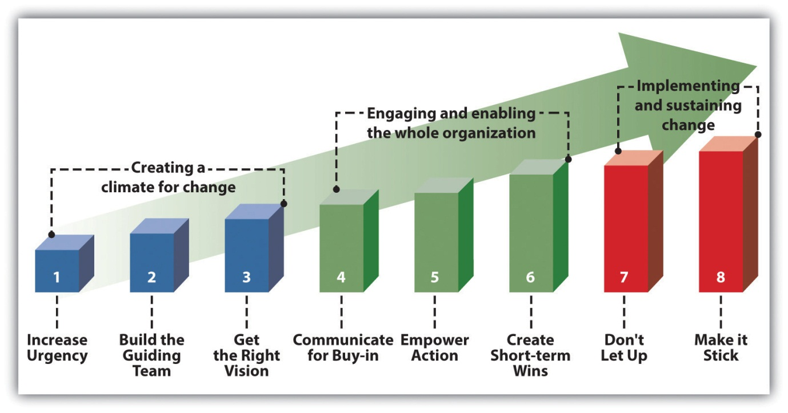
CHANGE AND TRANSITION
Provincial team:
Governance:
Steering com.
Key decisions
Risk management
Implementation:
Project team
Change and Trans.
Learning & Knowledge
Enablement/ training
Risk management
Sustaining SCOA:
Oversight role
Templates
Self assessments
Implementation:
Project team, planning, preparation
Change and Trans.
Vendor appointment and management
Enablement/ training in municipality
Risk management
Sustaining SCOA:
Oversight role
Municipal team:
Templates
Self assessments

Slide 7
PROVINCIAL FEEDBACK
CRITERIA | RATING
Project governance | Partially implemented or considered
Project team | Identified but not appointed
Project planning/ admin | Needs attention
ICF and other forums | Well attended
List/ liaison with stakeholders | Lists compiled but not engage as yet
Risk registers | Needs attention
FAQ database | To be communicated and monitored
Training participation | Well attended, asked for more
Change management | Only started

Slide 8
WORKSHOPS
Three presentations:
Change management
Knowledge management
Vision and business case
Three workshop groups:
Vision, core message and business case
Knowledge management
Engagement plan

Slide 9
1. Review previous self-assessment 2. Review specific risks/ issues raised to date 3. Review progress to date, assist as required 4. Communication slides: Engaging and enabling the organisation 5. New self assessment
AGENDA FOR PROVINCIAL VISITS

Slide 10
Questions

