Slide 1

Demystifying Standard Chart of Accounts (mSCOA)
Chapter 3 – Classify, analyse and report on the economic classification using all segments of the standard chart of Accounts (mSCOA)
Presented by National Treasury: Chief Directorate Local Government Budget Analysis

Slide 2
Outcomes
Evaluate a transaction ensuring the correct use of all the segments of mSCOA.
Allocate a transaction using all segments of mSCOA.
Use inter-relationships amongst all the segments of mSCOA for allocation of transactions.

Slide 3
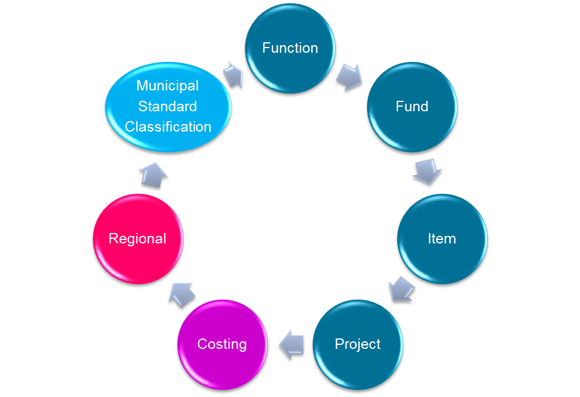
The 7 Segments of mSCOA

Slide 4
Understanding the mSCOA tables
mSCOA tables are developed in Microsoft Excel
Item segment broken into 4 sub segments namely:
  Revenue
  Expenditure
  Gains and losses
  Assets, liabilities and Net assets

Slide 5
Understanding the mSCOA tables – Explanation of headings
Posting Level | VAT Status | Code Structure Account No. | Count | Posting Level (Yes/No) | Breakdown Allowed (Yes/No) | Principle | Application
Contains the account posting level based on a “string” providing a relative link to the reporting levels
Include an abbreviation giving guidance on the VAT implications generally associated with the type of transaction
is based on the levels presented in the hierarchical structure of the classification within the segment
count of the characters used in building the posting level description
This indicator informs if the account is a posting level or reporting level. If “Yes” this account is the posting level and “No” indicates a non-posting level
This indicator guides if “additional detail on a posting level” could be added or not. If detail is provided for this will become the default posting level
guidance on the detail to be added and the context with in which expansion need to be consideredDepending on the Segment the additional information would be required to set the posting level
provides detail on the relevance of the account to municipalities, district municipalities and municipal entities

Slide 6
The structure of the chart – Version 5.1
  Posting and non posting levels
Segment detail | No. of Rows | District % | Local % | Metro %
Function | 170 | Low | Medium | High
Fund | 5,259 | Low | Medium | High
Item: Assets, Liabilities and net Assets | 21,368 | Low | Medium | High
Item: Expenditure | 5,728 | Low | Medium | High
Item: Gains and Losses | 145 | Low | Medium | High
Item: Revenue | 5,670 | Low | Medium | High
Project | 730 | Low | Medium | High
Costing | 96 | Low | Medium | High
Regional | 1,229 | Low | Medium | High
Total | 40,395 | Low | Medium | High

Slide 7
The structure of the chart – Version 5.1
  The code structure assigned to the various SCOA Segments contains an alphanumerical character to define the segments followed by a numerical structure representing the various levels within the reporting structure
Code | Segment
C | Costing
F | Fund
FX | Function
IA | Item Segment: Assets, Liabilities and Net Assets
IE | Item Segment: Expenditure
IZ | Item Segment: Gains and Losses
IR | Item Segment: Revenue
P | Project
R | Regional Indicator

Slide 8
The structure of the chart – Version 5.1
  The multi-dimensional SCOA classification framework does not necessitate a fixed account structure. However, it is recommend the following fixed structure can be for utilised throughout all municipalities and municipal entities in ensuring consistency should the system application be able to accommodate the coding
Segment | Function | Fund | Item | Project | Costing | Regional Indicator
Code Count Total: 86 | 13 columns 3 digits | 13 columns 3 digits | 13 columns 3 digits | 13 columns 3 digits | 13 columns 3 digits | 13 columns 3 digits
  The structure is built to accommodates other stakeholders, currently the following are accommodated.
    Department of Water Affairs
    NERSA
    SARS
  Others may follows as mSCOA evolves
  In the current piloting phase mSCOA is living document.

Slide 9
The structure of the chart – Version 5.1
  Demonstration of the Excel version of the chart
    Highlighting the following
      Posting/Non posting levels
      Breakdown allowed
      Definitions of transactions
      Application to District and local Municipalities and Metros
      Use of filters
  Function segment

Slide 10
The Fund Segment
The Funding Segment in the financial system identifies the various sources of funding available to municipalities for financing expenditure relating to the operation of the municipality for both capital and operational spending.
“against which source of funding is the payment allocated and against which source is revenue received?”

Slide 11
The fund segment – Level 1
Refer to pages 30 and 31 of the Project Summary Report for the definition of these
terms

Slide 12
The fund segment – Revenue – Level 2 and 3
Darker shading and white font denotes posting levels

Slide 13
The fund segment – commercial services – Level 2
Darker shading and white font denotes posting levels

Slide 14
The fund segment – borrowing– Level 2 and 3
All non posting with further breakdown allowed

Slide 15
The fund segment – Transfers and subsidies – Level 2, 3 and 4
All non posting with no further breakdown allowed

Slide 16
The Function Segment
The “Function Segment” is the location within the SCOA for creating the “vote” structure standardised for all municipalities
“against which function should the transaction be recorded?”

Slide 17
The Function Segment –Overall and definitions
This is linked to GFS
Vote
  “a) one of the main segments into which a budget of a municipality is divided for the appropriation of money for the different departments or functional areas of the municipality and (b) which specifies the total amount that is appropriated for the purposes of the department or functional area concerned”
Core functions
  provides for the matters in terms of sections 156 (1) of the Constitution. These are functions performed by local government constitutionally assigned to local government in terms of Part B of Schedule 4 and Part B of Schedule 5.
Non Core functions
  functions performed by local government that are constitutionally assigned to provincial government in terms of section 156(4) of the Constitution. Local Government are compensated for delivering the service on behalf of provincial government and receive a management fee from the provincial department.

Slide 18
The Function Segment –Overall and definitions
The functions that a municipality adopts is based on the constitution and the arrangements with either the national and provincial governments.
The function/sub-function approach has been adopted by municipalities for several years. At present this segment is implemented mostly through the use of mapping tables designed by the system vendors, with a few municipalities adopting the function/sub-function as their organisational structure. Where municipalities ‘vote’ structure is aligned to these functions and sub-functions the municipal standard classification will become obsolete.
the “vote” also allows for comparisons between municipal budgets; a comparison of the annual budget year-on-year (even if the organisational structure is amended by a shift of departments/functions); and a comparison and benchmarking of the budgets of different municipalities in South Africa and other countries. These comparisons are only possible if there are consistent definitions for “votes, departments and functions”.

Slide 19
The Function Segment –Overall and definitions
The structure of a vote (within the Municipal Standard Classification Segment) should not require re-organisation or restructuring of a municipality, as long as a municipality largely defines its departments around key functions or sub-functions.
Cross functional departments are catered for
It is highly recommended that the”functional classification” be adopted by all municipalities as their respective “vote” structure.
If the above is applied it will reduce the standard segments to 6
The municipality needs to allocate the activities carried-out by each senior manager’s department to one or more of the sub-functions. This approach recognises the dynamism of any organisation, although allowing for reporting in the functional manner.
Keeping the “vote” at a high-level allows senior managers to move expenditure and revenue as necessary within a “vote” without an adjustments budget provided the overall revenue, expenditure and performance objectives for that “vote” are not negatively affected

Slide 20
The Function Segment – Level 1
Refer to pages 32 to 34 of the Project Summary Report for the definition of these
terms

Slide 21
The Function Segment – Finance and Administration - Level 1 to 4
Darker shading and white font denotes posting levels

Slide 22
The Function Segment – Environmental protection - Level 1 to 4
Darker shading and white font denotes posting levels

Slide 23
The Item Segment - Introduction
“What is being bought or money received for?”

Slide 24









The Item Segment - Introduction

Slide 25
The Item Segment - Introduction
The mSCOA project will lead to the alignment of the budget reporting format and annual financial statements.
  This will greatly assist the reporting on budget versus actual information
Important to note is that the accounting policies, methodologies and principles applied in determining budgetary information need to be consistent to those applied in preparing annual financial statements.

Slide 26
The Item Segment - Revenue
Fund Segment could be interpreted as a duplication of the content of the Revenue Components from the Item Segment.
The Fund Segment records the “source of funding available and is represented by money in the bank” whilst the revenue component is driven by accrual accounting principles.
Revenue encompasses both revenue and gains.
We have discussed the high level components of revenue in chapter 2.
“what is the type and nature of the revenue accrued?”

Slide 27
The Item Segment - Expenditure
We have dealt with the high level components of expenditure in chapter 2.
The definition of expenses encompasses losses as well as those expenses that arise in the course of the operating activities of the entity.

Slide 28
The Item Segment - Expenditure
We have dealt with the high level components of expenditure in chapter 2.
The definition of expenses encompasses losses as well as those expenses that arise in the course of the operating activities of the entity.
“what is the type and nature of the expenditure incurred?”

Slide 29
The Item Segment - Expenditure

Slide 30
The Item Segment – Expenditure – Level 3
Bad debt written off
  Shown by category, Electricity, Property Rates etc.
Contracted Services
  This group of accounts distinguish between "outsourced services, contractors and professional and special services".
Depreciation and Amortisation
  Amortisation is the systematic allocation of the discount, premium or issue cost of a financial instrument over the life of the instrument, or an intangible asset over a certain period
Employee related costs
  Senior Management
  Municipal Staff
Inventory
  Consumable stores, Finished goods, Goods held for resale etc.

Slide 31
The Item Segment – Expenditure – Level 3
Remuneration of councillors
Operating leases
  Shown by asset class as per PPE
Operational costs
  62 item shown e.g. Audit cost external, Bursaries (employees), catering municipal activities, Drivers license and permits, Entertainment, Honoraria, Management fees, Travel agency fees, Professional bodies, Resettlement costs, Transport provided as part of departmental activities, Travel and subsistence, warrantees and Guarantees, Wet Fuel
Transfers and subsidies (Unrequited payments) either in cash or in kind
  Capital
  Operational
Income tax – Applicable to municipal entities

Slide 32
The Item Segment – expenditure - definitions
Distinguish between the following
  Auditors
    Expenditure: Contracted Services - Outsourced Services: Business and Advisory - Accountants and Auditors
    Expenditure: Contracted Services - Consultants and Professional Services: Business and Advisory - Accountants and Auditors
    Audit cost external
  Bursaries
    Expenditure: Operational Cost - Bursaries (Employees)
    Bursaries to non employees
  Catering
    Expenditure: Contracted Services - Outsourced Services: Catering Services
    Expenditure: Operational Cost - Catering Municipal Activities
    Expenditure: Operational Cost - Entertainment

Slide 33
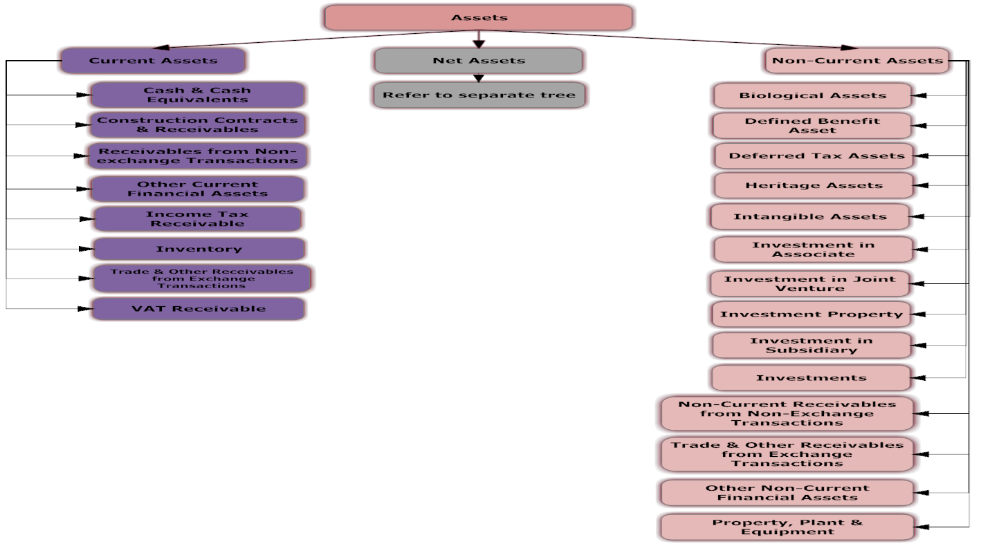
The item segment – Assets, Liabilities and Net Assets

Slide 34
The item segment – Assets, Liabilities and Net Assets - Definitions
An asset shall be classified as current when it satisfies any of the following criteria:
  it is expected to be realised in, or is held for sale or consumption in, the municipality’s normal operating cycle;
  it is held primarily for the purpose of being traded;
  it is expected to be realised within twelve months after the reporting date;
All other assets shall be classified as non-current and includes tangible, intangible, and financial assets of a long-term nature
A liability shall be classified as current when it satisfies any of the following criteria:
  it is expected to be settled in the municipality’s normal operating cycle;
  it is held primarily for the purpose of being traded;
  it is due to be settled within twelve months after the reporting date

Slide 35
The project segment
The project segment is linked to the IDP of the municipality
Due to the IDP being a 5 year plan, the need for a project segment was identified
The accumulation of project-related transactions in a single posting-level account results in a classification not relating to “what is bought”.
The Project Segment distinguishes projects according to the nature of the expense whether it is capital or an operational expense.
“Does the transaction relate to a specific project and if so, what type of
Project?”

Slide 36
The project segment
All activities of the municipality would therefore need to be aligned to “Projects” segment, including institutional costs associated with the functioning of the municipality such as cost for the administrative and staff; this allows for planning and budgeting on a project level.
The “Project” segment together with the “Funding”, “Regional” and “Function” segments contribute in reporting on strategies and putting into actions projects by providing for it in the budget.
The project lifecycle will not be informed by the mSCOA

Slide 37
The project segment - Definitions
Capital
  Infrastructure
    while there is no universally accepted definition of infrastructure assets, these assets usually display some or all of the following characteristics: 1) they are part of a system or network; 2) they are specific in nature and do not have alternative uses; 3) they are immovable and 4) they may be subject to constraints at disposal”.
  Non-infrastructure
    Transactions of a capital nature relating to key projects as identified by management, e.g. procurement of a new bus fleet for use as urban transport but not qualifying as "infrastructure assets“
Default Transactions
  Default account for transaction not relating to either capital or operational expenditure and of no specific interest in the context of this Segment.
Operational
  current and short term projects for which the cost is immediately recognised as an expense and funded from the municipalities' operational budget.

Slide 38
The project segment - Definitions
What makes up the cost of a project?
  Employee related costs
  Operational costs
  Depreciation (Capital costs)
  Interest (Borrowing costs)
Project costs are either associated to a project at the initiation of the primary costs, or during a secondary costing process.
The project segment will be expanded on during the 3 day practitioner course.

Slide 39
The project segment – capital

Slide 40
The project segment – capital - Infrastructure
Existing
  Rehabilitation and Refurbishment (By type of asset)
    Includes activities that are required due to neglect or unsatisfactory maintenance or degeneration of an asset. The action implies that the asset is restored to its original condition, enhancing the capacity and value of an existing [asset that has become inoperative due to the deterioration of the asset.
  Upgrade and additions (By type of asset)
    Includes activities aimed at improving the capacity and effectiveness of an asset above that of the intended purpose. Not dictated by the condition of the asset.
New
  Projects of a capital nature undertaken to create "new-infrastructure assets" as per definition of an "infrastructure asset".
Transfers
  Unrequited payment. Further broken down to
    Rehabilitation and Refurbishment
    Upgrade and additions

Slide 41
The project segment – capital – Non -Infrastructure
Rehabilitation and Refurbishment (By type of asset)
  specific to non-infrastructure assets includes activities that are required due to neglect or unsatisfactory maintenance or degeneration of an asset.
Upgrade and additions (By type of asset)
  Specific to non-infrastructure assets include activities aimed at improving the capacity and effectiveness of an asset above that of the intended purpose.
Transfers
  Unrequited payment. Further broken down to
    Rehabilitation and Refurbishment
    Upgrade and additions

Slide 42
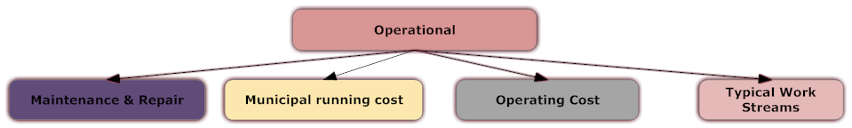
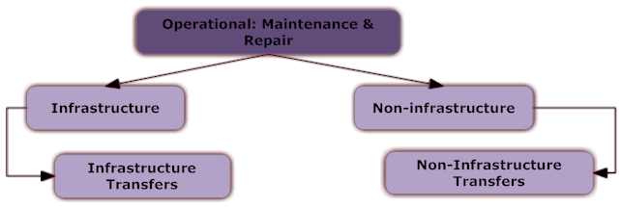
The project segment – Operational

Slide 43
The project segment - operational
Maintenance and repairs
  Maintenance and Repair (including overhaul) involves fixing any sort of mechanical or electrical device should it become defective or broken (known as repair, unscheduled or casualty maintenance). It also includes performing routine actions which keep the device in working order (known as scheduled maintenance) or prevents trouble from arising (preventive maintenance).
Maintenance and repairs – Infrastructure
  By categories of infrastructure e.g. Airports, Electricity etc.
Maintenance and repairs – Non - Infrastructure
  By categories of non - infrastructure e.g. Building, computer equipment

Slide 44
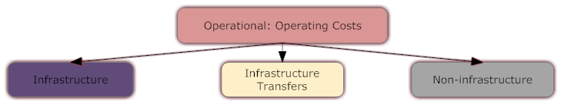
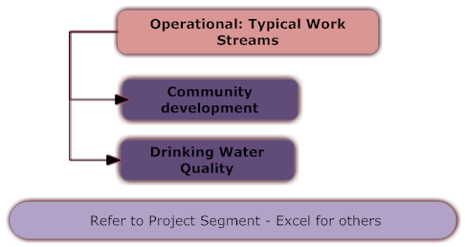
The project segment – Operational
The operational – municipal running cost, will be default for expenditure that is not project related.

Slide 45
The project segment – Operational : Typical work streams
Projects are created under this group for “operational projects” for example agricultural projects, capacity building, training and development, spatial planning, etc. Typically these “projects” consist of various expense-items contributing to the outcome or objective of an initiative. Default projects are included for guidance but the Municipality could expand these as considered necessary.

Slide 46
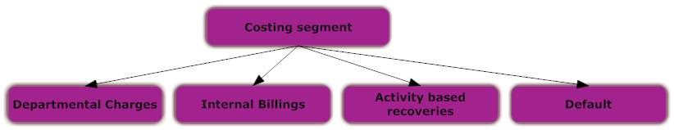
The costing Segment
The “Cost “segment provides for the classification of indirect (secondary) costs that do not directly attribute to the output and are sometimes referred to as activity based recoveries, for example labour, vehicle, plant and equipment, internal service charges (internal billings), and departmental charges for example office rental, audit fees and procurement.
Indirect cost (secondary cost) is initially recorded as primary cost within the “Item “segment and funded according to the indicator selected in the “Fund” segment. The costing indicator within the “costing” Segment provides for the re-distribution of these primary costs between functions (no change in the funding source), together with indicators provided in the “Cost” segment. The “Project” segment provides the classification link to these indicators and specific projects.
The purpose for including this segment in SCOA is to provide for the recording of full cost reflection for at least the four core municipal functions being electricity, water, waste water and waste management services, as a minimum requirement (for now).
“Should the cost be reallocated to functions rendering services?”

Slide 47
The costing segment

Slide 48
The costing segment – Cost Recovery Approach
Pro-Rata Approach
  This approach where it is not possible or too costly to identify actual resource usage. The costs are allocated on a proportionate allocation basis to outputs by using measures such as:
    Staff involved in production of the output as percentage of total staff;
    Direct resource use in the production of the output as a percentage of total resource use; and
    The budget for the output as a percentage of the total budget.
The “Usage” or “Benefit” Approach
  This approach is concerned with measuring the actual usage of resources. Examples of apportioning an indirect cost are direct observation, time (in case of indirect staff costs) and log sheets (in case of vehicle and plant equipment)

Slide 49
The costing segments - Definitions
Departmental Charges
  This refers to the allocation of overheads to cost centres for example information technology. Distribution could be based on a pro rata allocation based on number of service points or users within the receiver departments (e.g. electricity department).Some financial applications refer to this classification as assessment charges.
Internal Billings
  This refers to departmental use of internal services such as electricity, water, waste water management and waste management, for example cost allocation for the electricity department’s water consumption or the electricity consumed in the purification of water process.
Activity based recoveries
  This refers to the actual allocation of resources utilised by various departments, for example, allocation of labour is based on time sheets, and the allocation of vehicles and plant equipment is based on log sheets
Default
  All transactions not relevant to the allocation of secondary cost to be classified within this account.

Slide 50
The costing segment – Departmental charges

Slide 51
The costing segment – Internal billings

Slide 52
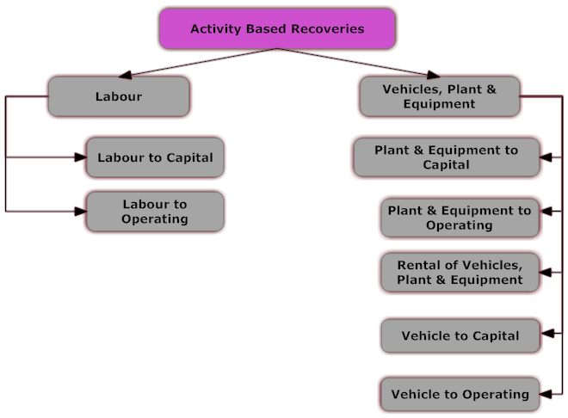
The costing segment – Activity Based Recoveries

Slide 53
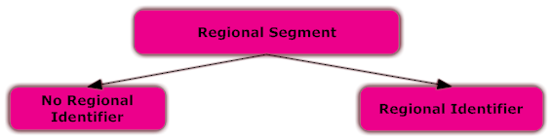
The Regional Segment
The purpose of the regional segment is to assign municipal expenditure and some revenue to the lowest relevant geographical region to identify the communities that benefit from spending. This implies that expenditure must be recorded so that the final impact of such spending can be measured by region in order to get a regional view of the economic impact of government spending.
“which geographical area is deriving the benefit from the transaction, or from where is the revenue generated”?

Slide 54
The Regional segment
It is envisaged that this information will enable and support enhanced analysis of:
  Whether services are being provided impartially, fairly, equitably and without bias, as required by the Constitution.
  Whether progress is being made in addressing regional backlogs in social infrastructure and access to services.
  Whether government spending by different departments and municipalities are being properly sequenced and co-ordinated.
  Whether actual spending by government is aligned to the relevant plans of the three spheres of government.
  Assist councillors and mayors to account to the communities for resources allocated and actual spending of the municipality to communities and wards.
  Provide specific ward information to councillors to assist in decision-making.

Slide 55
The regional segment - Structure

Slide 56
The regional segment - Structure
The core-principle of assigning government expenditure in line with the above purpose of the “Regional” segment is: “to identify the lowest relevant geographical region of the intended beneficiaries of the service or capital investment that is being financed by the particular expenditure”.
  The lowest relevant geographical region’ refers to the ward, municipality, district or province where the intended beneficiaries normally live or are located. Note that the ‘lowest relevant geographical region’ is not necessarily restricted to the municipality where the service or capital investment is located, since the intended beneficiaries may be from neighbouring municipalities, even neighbouring provinces, depending on the nature of the service or investment (for further details see below).
  ‘intended beneficiaries’ refers to the individuals or entities (such as businesses) that are intended to benefit directly from the given service or capital investment.
  ‘the service or capital investment’ refers to the output that is being delivered or produced by the government department; and
  ‘the particular expenditure’ refers to the expenditure that is being captured. Note that in nearly all instances this expenditure will only constitute a part of the cost of the service or capital investment.

Slide 57
The regional segment - Structure
It is important to note that the location of the service provider is not relevant when it comes to capturing information in relation to the “Regional” segment.

Slide 58
The regional segment – The Allocation Principle
Services Benefiting Multiple Regions or Wards
  Often allocating a particular expenditure to the “the lowest relevant geographical region” will be complicated by the fact that either:
    The relevant service or capital investment benefits people in more than one area or ward (e.g. road whose route crosses a number of wards), or
    The expenditure is in relation to a contract for the provision of goods and services in more than one area or ward. A typical example is expenditure on goods purchased under a transversal contract, or normal bulk purchase contracts.
  To address both of these instances, the system allows for the identification of multiple regions at the area or ward-levels.
Methods of Allocating Expenditures to Multiple Regions
    expenditures equally among the service centres/geographical management areas/regional areas, wards, regional offices or districts, etc.;
    expenditures according to a fixed percentage based on the proportion of the services delivered in each function/service areas/regional areas, wards, regional offices or districts, etc. or based on the population of the service centres/geographical management areas/regional areas, wards, regional offices or districts, etc; and
    transactions according to management’s decision of how the function/service areas/regional areas, wards, regional offices or districts, etc. are benefitting from the services related to that particular expenditure.

Slide 59
The regional segment – Potential difficulties
The greatest challenge is to get all municipalities to:
  Align their regional structures with the provincial, district and municipal boundaries as defined by the Municipal Demarcation Board.
  Define the service areas of each of the offices of the municipality.
  Gather the information from metros and municipalities to set-up the detail according to the “logistical arrangement”.

Slide 60
The Municipal Standard Classification Segment
Non Standardised segment
“against which organisational vote or sub-vote should the transaction be recorded”?
This segment contains the “votes” set-up by the municipality based on the organisational structure in place for the municipality. The “vote” structure needs to be aligned to the municipality’s organisational structure.
Municipal revenue, operating and capital expenditure are then classified in terms of each of these votes. This means it is possible to present the operating surplus or deficit for each vote, along with information on the proposed capital budget. If a municipality delivers services within a particular vote structure these tables enable, useful performance information based on the vote structure

Slide 61
All 7 segments – Allocating a transaction
mSCOA is the combination of all 7 segments for a single transaction. The type of typical transactions are:
  Revenue Invoices
  Revenue debit notes
  Receipts
  Supplier Invoices
  Supplier credit notes
  Payments – disbursement
  Petty cash transactions
  General Journal
  Etc.
Each municipality have they own mechanism to enter a transaction into its accounting system. For the purposes of this training we have designed a form that emphasises the 7 segments.

Slide 62
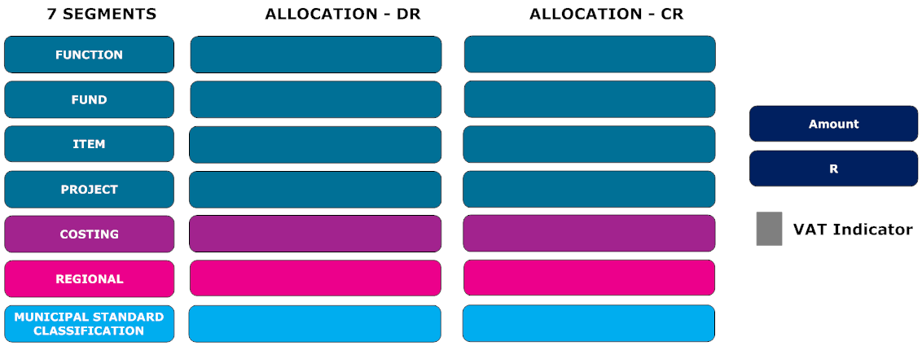
All 7 segments – Allocating a transaction

Slide 63
All 7 segments – Allocating a transaction – An example
Ms Cool from KwaDukuza Municipality, who works in the roads Department. Her office is based in KwaDukuza. Her PA books a flight to Pretoria to attend a mSCOA workshop. They book a flight on a domestic airline. The cost of the ticket is R2,750.00. Please allocate this transaction.
Excel Form

Slide 64
All 7 segments – Allocating a transaction – Typical transaction – Purchase of Inventory
The supply chain management office, in the Blue Crane Route Municipality purchases 1,000 pens at a cost of R3,500. The PA of the chief financial officer, received 50 pens from Stores. Please allocate these 2 transactions.

Slide 65
All 7 segments – Allocating a transaction – Typical transaction – Purchase of Inventory

Slide 66
All 7 segments – Allocating a transaction – Typical transaction – Reallocation of Inventory

Slide 67
All 7 segments – Allocating a transaction – Typical transaction – Revenue
The city of Tshwane issues a bill to Mr Dam for his monthly electricity consumption for an amount of R1,140, for the month of August 2014? Please allocate only the Cr side of the transaction.

Slide 68
All 7 segments – Allocating a transaction – Typical transaction – Revenue

Slide 69
All 7 segments – Allocating a transaction – Typical transaction – Expenditure - Current
The City of Tshwane accounts for an invoices received from Eskom for bulk purchase for an amount of R1,140,000.00. Please allocate the debit leg of this transaction.

Slide 70
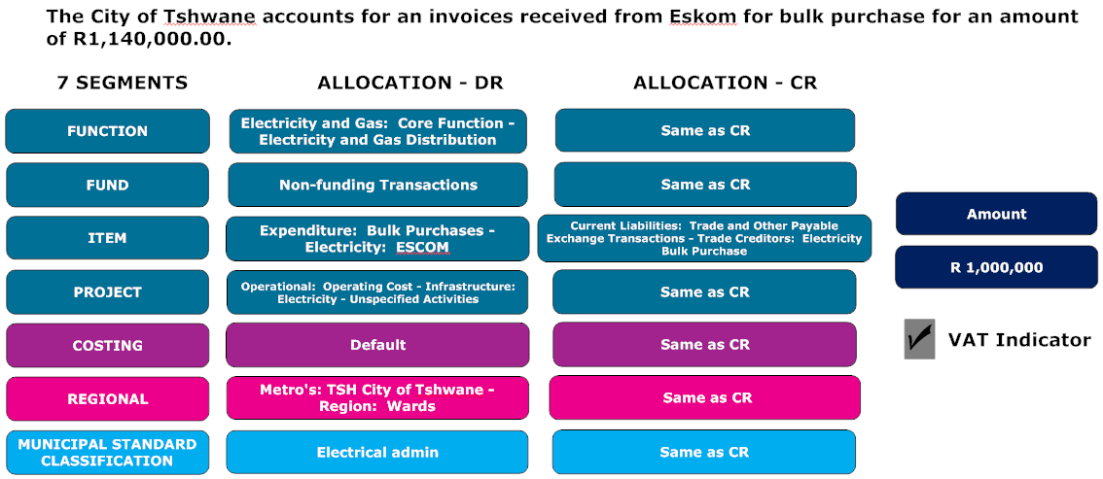
All 7 segments – Allocating a transaction – Typical transaction – Expenditure - Current

Slide 71
All 7 segments – Allocating a transaction – Typical transaction – Expenditure - Capital
The City of Tshwane purchases a desk for the Municipal Manager for an amount of R11,400. Please allocate the Debit leg of the transaction.

Slide 72
All 7 segments – Allocating a transaction – Typical transaction – Expenditure - Capital

Slide 73
All 7 segments – Allocating a transaction – Typical transaction – Expenditure - Transfers
The City of Tshwane transfers an amount of R10,000,000 to the Gauteng Housing department for building of Taxi Rank. Please allocate the debit leg of this transaction.

Slide 74
All 7 segments – Allocating a transaction – Typical transaction – Expenditure - Transfers

Slide 75
Allocation of transactions
What does the municipality do from here
  Find typical day to day transactions and work out your allocations.
  Find secondary allocation for the Project and costing segment.
  Find non typical transactions and work out your allocations.
  For transactions you cannot find the allocation, send an email to lgscoa@treasury.gov.za

Slide 76

Questions

