Slide 1
mSCOA GRAP Workshop Tariff Setting Aligned to mSCOA
Presented by National Treasury: Chief Directorate Local Government Budget Analysis – 12 July 2016

Slide 2
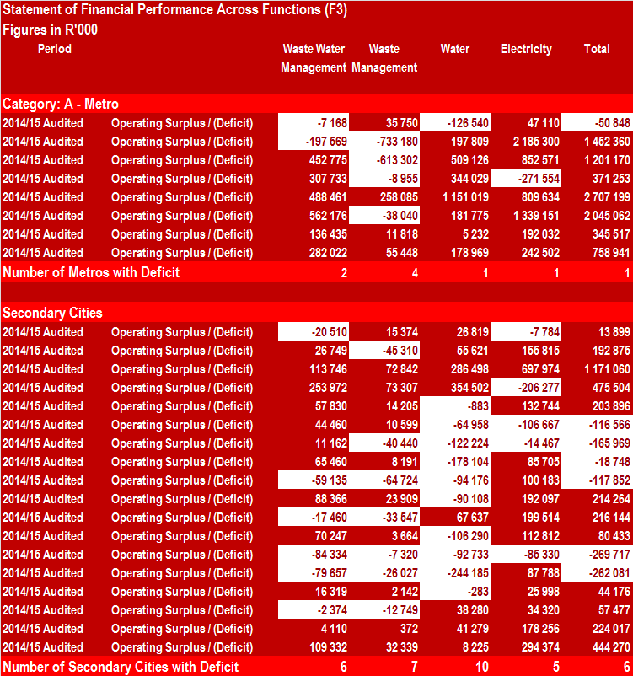
Financial Results – Trading Services 2014/15

Slide 3
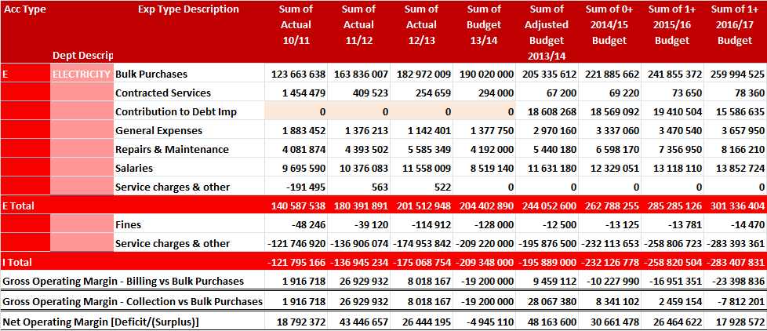
Example – Trading Services – Insufficient Cost Recovery

Slide 4
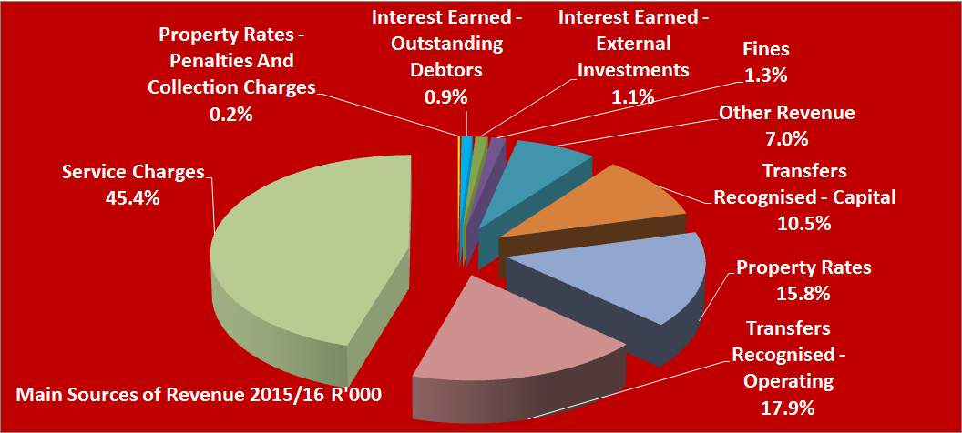
Main Sources of Revenue
Tariffs - Service Charges – 45.4% of total municipal revenue
Property rates – 15.8% of total municipal revenue
Assessment Rates & Tariffs - most significant revenue source available to local authorities – Maximising Revenue Essential

Slide 5
Requirements for Proper Tariff Setting
1. Annual Budget - The main purpose of preparing a budget could be summarised as follows:
Provides detail of
Revenue sources available
Expenditure requirements
Tool for implementation of Council policies
Forms the basis for control over revenue and expenditure
Forms the basis for tariff calculation – Cost of rendering the service
2. Type of Services and Tariff Setting
Trading services (Full cost recovery plus a budgeted operating surplus)
Economic Services (Budgeted to break even – full cost recovery)
Subsidised services (Not full recovery of cost to provide the service – some tariffs)
Community services (No tariffs – funded from assessment rates and surpluses from trading services)

Slide 6
Requirements for Proper Tariff Setting
3. Tariff Policy
The tariff policy is the key to transparent tariff setting that outlines how tariffs are determined, monitored and reviewed to assure its citizens that tariffs are set on a rational basis
Objective of the tariff policy is to ensure that:
Tariffs of the Municipality conform to acceptable policy principles
Municipal services are financially sustainable
There is certainty in the Council and community of how the tariffs will be determined
Tariffs of the Municipality comply with the applicable legislation

Slide 7
Requirements for Proper Tariff Setting
3. Tariff Policy
Need for a tariff policy
Revenue adequacy and certainty - the Municipality must:
Have access to adequate sources of revenue to enable it to carry out its functions.
Fully exploit the available sources of revenue to meet its developmental objectives; and
Be reasonably certain of its revenue to allow for realistic planning
Sustainability - Financial sustainability requires that the Municipality must ensure that:
Its budget is properly funded This means that the Municipality must ensure that:
Services are provided at affordable levels; and
It is able to recover the costs of service delivery

Slide 8
Requirements for Proper Tariff Setting
Need for a tariff policy (Continued)
Effective and efficient usage of resources
Resources are scarce and must be used in the best possible way to ensure the maximum benefit for the community
Tariffs must accurately reflect the costs incurred in providing a service
Accountability, transparency and good governance - The Municipality must be accountable to the community for the use of its resources and must be able to:
Justify their expenditure decisions
Explain why and how the revenue necessary to sustain expenditure, is raised
Budgeting and tariff setting must be open to public scrutiny
The community should be part of the decision making process about how revenue is raised and spent

Slide 9
Requirements for Proper Tariff Setting
Need for a tariff policy (Continued)
Equity (fairness)–
The Municipality must treat members of the community equitably with regard to the provision of services
Users should pay for a service in proportion to the costs that are incurred in providing them with that service
Need for subsidisation, either from National government or cross-subsidisation from within the municipality
Development and investment
Meeting basic needs in the context of existing services and backlogs, will require increased investment in municipal infrastructure

Slide 10
Requirements for Proper Tariff Setting
4. Demand and Service levels
Important step in setting a tariff for the main trading and economical services is to understand the demand for the services. Identify the following:
Number and type of consumers - four basic categories of consumer:
Domestic - households who use services to meet their own requirements
Commercial - businesses that provide services and use municipal services to meet the consumption requirements of their staff and customers
Industrial - Industrial consumers are businesses that are involved in the manufacture of products and use municipal services in their manufacturing processes
Institutional - Institutional consumers are organisations dedicated to providing services that are of benefit to the community, and include schools, hospitals, places of worship, orphanages and so on.

Slide 11
Requirements for Proper Tariff Setting
4. Demand and Service levels (continued)
Levels of service to which they have access –
Mainly three service levels:
Basic (Low) Level of Service
Medium Level of Service
High Level of Service
Service level available determines:
Type of infrastructure that is installed
Affects their consumption of that service
Affects the cost of providing the service - different tariffs are levied for different levels of service

Slide 12
Requirements for Proper Tariff Setting
4. Demand and Service levels (continued)
Current levels of consumption of services
Where consumption can be measured
Tariffs levied based on the level of consumption of a service
Determination of levels of consumption is crucial factor in tariff setting
Measuring consumption differs for different services:
Electricity and water – measured in units consumed (kwh & kl)
Waste management – measured in mass or volume removed as well as frequency of the service or number of collection points
Waste Water management – measurement – various scenarios:
Can be estimated based on levels of water cons (66%-70%)
Can be estimated based on property value
Can be estimated based on number of toilets
No measurement – tariff based on a flat rate
Other non-trading services consumption refer to numbers of times that the service is used (example, number of library books borrowed)

Slide 13
Requirements for Proper Tariff Setting
5. Determine “full costs” to provide a service
Full cost of providing a service includes:
Direct (primary) costs: Day-to-day costs incurred in running the service
Costs incurred exclusively in providing a particular service.
Direct costs include:
Employee related costs: all expenditure related to the personnel required to provide the service. This includes normal salaries and wages, any bonuses paid, overtime costs, allowances, fringe benefits and social contributions.
Bulk purchases: the cost of purchasing bulk water and electricity from an external provider, where relevant.
Repairs and maintenance: the cost of any materials or equipment used to repair and maintain fixed assets.
Contracted services: the cost of any services that have been contracted out to external providers.
Other costs: all expenditure not grouped under one of the other categories.

Slide 14
Requirements for Proper Tariff Setting
5. Determine “full costs” to provide a service (continued)
Full cost of providing a service includes:
Indirect (secondary) cost: Overhead costs of running the municipality as a whole
Costs that are not directly attributable to a service but are incurred in running the municipality as a whole
Overheads must be apportioned between services in a clear, structured way
Capital financing costs: costs to expand and manage infrastructure
Costs associated with financing infrastructure expansion and with rehabilitating and/or replacing existing infrastructure as it ages
Adequate provision for capital financing costs is vital to ensure that service provision is sustainable in the long term

Slide 15
Requirements for Proper Tariff Setting
5. Determine “full costs” to provide a service (continued)
Capital financing costs include:
External interest associated with financing capital expenditure using external loans.
Depreciation - cost of ‘consuming’ assets in service delivery
Proper depreciation accounting results in a cash surplus on the operating account which can be transferred to reserve used to finance asset replacement
Cash funding of depreciation is a challenge due to impact on tariffs
Provisions to capital reserves: a cost item used to create a cash surplus on the operating account which can be transferred to a reserve used to finance asset expansions
Next few slides deals with the expected alignment & impact of the various mSCOA segments on determination of the full cost of services

Slide 16
Full Cost Recovery – Cost of Providing the Service – mSCOA Segments
Function Segment - Classification of Functions of Government (COFOG) – IMF 2014 – Previously GFS
Community and Social Services
COFOG
Core Services – Municipality mandated to render the service
Energy Sources
Environmental Protection
Executive and Council
Finance and Administration
Health
Housing
Internal Audit
Other
Planning and Development
Public Safety
Road Transport
Sport and Recreation
Waste Management
Waste Water Management
Water Management
Non-Core Services – Municipality not mandated to perform the function – SLA with DM or Provincial Entity
Identify the core service for service charges as being
Tariff Policy needs to identify which functions will be charged out as indirect (secondary) cost
Electricity
Waste management
Waste Water, management
Water

Slide 17
Full Cost Recovery – Cost of Providing the Service – mSCOA Segments
Item Segment - Revenue
Exchange Revenue – mSCOA chart
Item Segment - Revenue
Agency Services
Service Charges
Sales of Goods and Rendering of Services
Rental from Fixed Assets
Operational Revenue
Licences or Permits
Interest, Dividend and Rent on Land
Intercompany/Parent-subsidiary Transactions
Non-Exchange Revenue - mSCOA chart
Fines, Penalties and Forfeits
Licences or Permits
Property Rates
Surcharges and Taxes
Transfers and Subsidies
Non-Exchange Revenue – GRAP 23
Exchange Revenue – GRAP 9
Revenue items are presented in the high level mSCOA chart to the right and are separated into:
Revenue arises in the course of the operating activities of the municipality
Definition of revenue encompasses both revenue and gains
Contains the classifications structure for revenue estimates and is presented in the budget reporting format and actuals presented in the AFS

Slide 18
Full Cost Recovery – Cost of Providing the Service – mSCOA Segments
Item Segment - Expense
Definition of expenses encompasses losses as well as those expenses that arise in the course of the operating activities of the entity
Provide the direct (primary) cost for tariff setting
Highest-level supports the reporting done in terms of the budget reporting format and AFS
It take the form of an outflow or depletion of assets such as cash and cash equivalents, inventory, and property, plant and equipment
Expenditure items are presented in the high level mSCOA chart below
Expenses arise in the course of the operating activities and include cost of sales or cost of services rendered, wages and depreciation

Slide 19
Full Cost Recovery – Cost of Providing the Service – mSCOA Segments
Expense - mSCOA chart
Contra Accounts
Contracted Services
Default
Depreciation and Amortisation
Discontinued Operations
Employee Related Cost
Income Tax
Interest, Dividends & Rent on Land
Expense - mSCOA chart
Operational Cost
Remuneration of Councillors
Share of Deficit attributable to Associate
Share of Deficit attributable to Joint Venture
Share of Deficit attributable to Minorities
Statutory Payments other than Income Taxes
Transfers and Subsidies
Inventory Consumed
Operating Leases
Bulk Purchases
Bad Debts Written Off

Slide 20
Full Cost Recovery – Cost of Providing the Service – mSCOA Segments
Costing Segment
Costing Segment
Charges to receiving departments
Recoveries made by sending departments
Part of cost/management accounting
Zero sum exercise Charges (dt) = Recoveries (cr)
Indirect (secondary) cost is initially recorded as direct (primary) cost within the Item Segment and funded according to the Fund Segment.
Provides for the classification of indirect (secondary) costs that do not directly attribute to the output
Distinction is made between
Extracting information from multiple segments within SCOA would thus provide “full cost” information for the defined core municipal functions
Full cost forms the basis for tariff setting
Municipality needs to decide on the cost allocation model to be used
Activity based recoveries
Internal service charges (internal billings)
Departmental charges
Included in mSCOA to provide for the recording of “full cost reflection” for at least the four core municipal functions

Slide 21
Full Cost Recovery – Cost of Providing the Service – mSCOA Segments
Internal Billing
Internal Billing –Departmental use of internal services such as
electricity
In illustrating - the electricity consumed during water purification
waste management
waste water management
water
Activity Based Recoveries
Allocation of resources utilised by trading & economic services & various departments
Examples
Allocation of labour costs are based on time sheets
Allocation of vehicles and plant equipment cost are based on log sheets
This usually requires use of a costing module of the financial application
Requires weekly time & log sheet processing
Initially lack of information will complicate budget preparation
Departmental Charges
Department Charges (Support Services) - Allocation of overheads to cost centres:
Information technology used by multiple functions
Pro rata allocation based on the number of service points or users such as the electricity department

Slide 22
Full Cost Recovery – Cost of Providing the Service – Cost Allocation Model
mSCOA – Cost Allocation Model
mSCOA – Cost Allocation Model
Complexity of the design of a system depends on:
Municipality needs to decide on the cost allocation model to be used
Not necessary the case, cost allocation models can range in complexity from a simple Excel spreadsheet to something more complex such a full costing module
The size of the municipality
Cost of maintaining the system
Age of the infrastructure, and
Reporting structure within departments
Complexity and diversity of cost objects
Frequency at which cost are required
What level of information is required
The staff capacity
Two common methods of estimating the indirect costs:
A usage or benefit approach
A pro rata approach
Perception that the development and maintenance of costing models require significant resources

Slide 23
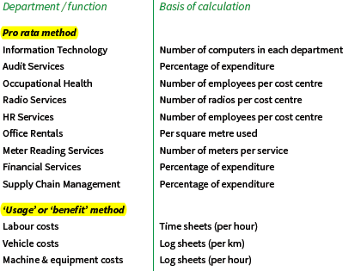
Full Cost Recovery – Cost of Providing the Service – Cost Allocation Model
Typical departments/cost centres that render internal services to the tariff departments (four core services) and possible basis of calculation for costing these services.

Slide 24
Full Cost Recovery – Cost of Providing the Service
Service Charges
All other internal revenue streams from fees, charges, penalties and fines
mSCOA
mSCOA
Revenue required for full cost recovery
Transfers
Direct (primary) cost
mSCOA
Full cost of Service Level/Standard
Indirect (secondary) costs – Costing Section
Departmental Charges
Internal Billings
Activity based Recoveries
Chosen Level/Standard of Service

Slide 25
Tariff Setting - Process
Tariff Policy – to guide the tariff setting process to ensure tariffs are set on a rational basis
Determine demand and service levels to facilitate the calculation of the full cost of service
Budget - utilise information from different mSCOA segments –
Determine total of all transfers and other revenue streams
Determination of full cost of providing the service
Type of Services and Tariff Setting for each service – operating surpluses from trading services to fund subsidised and community services
Determine funding deficit for the service to be recovered from service charges (tariffs)
Process for completion of tariff setting
Calculate the ‘primary baseline’ tariff
Revising the primary baseline tariff to achieving strategic goals
Make some strategic decisions
Select a tariff structure
Revise the baseline tariff in line with strategic decisions and selected tariff structures
Test adequacy and affordability of the tariff

Slide 26
Tariff Setting - Process
Calculate the ‘primary baseline’ tariff
Primary baseline tariff is the departure point for tariff setting
Mechanical calculation focussed on identifying a tariff that will achieve full cost recovery
Actual tariff levied may be above or below the primary baseline for some or all consumers types
Important to know the primary baseline tariff to understand the implications of setting a tariff below or above that level
The primary baseline tariff is simply calculated as the total cost divided by the number of baseline units
For water and electricity, the baseline tariff has a fixed and variable component
Fixed component is the fixed costs divided by number of consumers
Variable component is the variable costs divided by the total consumption of services (including any consumption that is given away free of charge)
The result will be a primary baseline tariff that is the same for all consumers and fully recovers all costs

Slide 27
Tariff Setting - Process
Revising the primary baseline tariff to achieving strategic goals
Tariffs are used to achieve a number of goals aside from full cost recovery - Goals might include:
Ensuring that services are affordable to domestic consumers or institutions,
Promoting local economic development by limiting the cost of services for commercial or industrial consumers,
Discouraging wasteful use of services by escalating the price of services consumed in large volumes.

Slide 28
Tariff Setting - Process
Necessary to make some strategic decisions - Baseline tariff is then revised
Does Tariff Policy prescribe a operating deficit or surplus on this particular service
Do you plan to give some of this service away free of charge –
Some levels of service provided free of charge for practical reasons - access water from communal standpipes
FBS subsidised by the equitable share
Is there a plan to subsidise the delivery of this service (excluding free basic service)
Do you wish to limit the tariff that a particular consumer type pays
Assist poor households by limiting tariffs to low income customers
Provide support to institutions by limiting the size of their tariffs
You may wish to promote local economic development by subsidising tariffs for commercial or industrial customers
Do you wish to escalate the tariff levied on certain types of consumers to
Discourage wasteful use of a service. For example, you may wish to discourage
Escalated tariffs on some consumer types in order to cross-subsidise reduced tariffs levied on other consumer types

Slide 29
Tariff Setting - Process
Select a tariff structure
Fixed charges
Recovers the fixed costs associated with providing the service
Serve as an availability charge on vacant stand where infrastructure has been installed
Fixed monthly fee charged per consumer, regardless of how much of a service that consumer uses
Simple to implement and very easy for customers to understand
Are not pro-poor - low income domestic consumer and a high income domestic consumer pay the same charge - relatively more expensive for low income customer
Do not promote conservation or efficient management of a service
Fixed charges can be used for some services in combination with a consumption based charge

Slide 30
Tariff Setting - Process
Select a tariff structure
Consumption based charges
Charges per unit of consumption (e.g. per kilolitre of water consumed, per grave dug or per library book borrowed
Regarded as equitable
Consumer who uses more of a service will pay more under this type of charge
Consumers can restrict the amount that a service costs them by restricting their consumption of the service

Slide 31
Tariff Setting
Different types of consumption based charge
Uniform rate - Constant charge per unit consumed
Rising block - Charge per unit consumed rises as larger amounts are consumed
Seasonal - Charge applied varies:
By time of year (winter electricity tariffs)
Daily during peak/off-peak times (electricity time of use tariff)
Revise the baseline tariff in line with strategic decisions and selected tariff structures
Primary baseline tariff is the tariff that will cover the full costs of providing the service
Strategic decisions outlined in the previous slides may require differentiated tariffs for some consumer types above or below the primary baseline level
A “revised baseline” tariff should be determined per consumer group with consideration of the strategic decisions made

Slide 32
Tariff Setting
Test adequacy and affordability of the tariff
Will the tariff generate sufficient revenue to achieve policy principles determined for this service
Tariffs should be tested by calculating the revenue that it will generate
Testing done based on available data on:
Numbers of consumers
Levels of consumption
Test adequacy and affordability of the tariff –
Will the tariff be affordable
No point in setting tariffs that theoretically generate sufficient revenue if tariffs are so high that consumers will be unable to pay them
Assessing the affordability of the tariffs is thus an important step
Accurate determination of affordability can only really be achieved by conducting comprehensive surveys
In the absence of such surveys commonly applied rule of thumb that households should receive a bill for all municipal services (including assessment rates) that is no more than 15% of their income

Slide 33
Tariff Setting
Final step to complete tariff setting is to determine the rate randage for assessment rates that will achieve:
Council adopting a funded budget in line with prescripts of section 18 of the MFMA
Budget provision for adequate cash backed surpluses to fund internally generate capital expenditure specifically for funding:
New assets
Renewal of existing assets

Slide 34
THANK YOU
Acknowledgements
Setting Tariffs - A guide for local government in South Africa, Namibia and Botswana
National Treasury Costing Methodology Guideline for Local Government
Lekwa Local Municipality Tariff Policy
mSCOA Project Summary Document
mSCOA Chart V5.5

