Slide 1
mSCOA Reporting Reference Group 2 March 2017
Presented by National Treasury
Notes:
1

Slide 2
Agenda
Purpose of Reporting Ref Group
Context in which Reporting Ref Group will function
Identification and prioritisation of reporting challenges
Getting the basics right
Registration for LG Upload Portal (Cornell)
Feedback on stress test conducted on 1 March 2017 (Trevor)
Registration of reporting queries / requests on FAQ (Cornell)
Format of the financial datasets (Marina)
Format of the non-financial datasets supporting financial datasets and reporting (Marina)
Dealing with challenges on A1 schedule for TABB reporting purposes
General work arounds to be implemented
The way forward and frequency of meetings

Slide 3
Purpose of the Reporting Reference Group
Not a decision making body
Main purpose
Open channel for support on production of datasets
Understanding of validation rules and reports
Standardisation of the production of MBRR schedules
Influence the next version of mSCOA classification framework
Find implementable work arounds for challenges
Keep a register of all issues on website
Ensure that work arounds and guidelines issued are implemented at municipalities

Slide 4
Context of the Reporting Reference Group
DWS
VAT
mSCOA framework
NERSA
MBRR
Section 71 reporting
CIDMS
GRAP
MFMA
SARB
ASB
AG
SARS

Slide 5
Identify Reporting challenges
Registrations on the LG Upload portal
Correct contact detail registered on LGDRS
Format of financial datasets
Definition of validation rules
Production of MBRR schedules
Management and control reports
Continuity of publications

Slide 6
The way forward

Slide 7
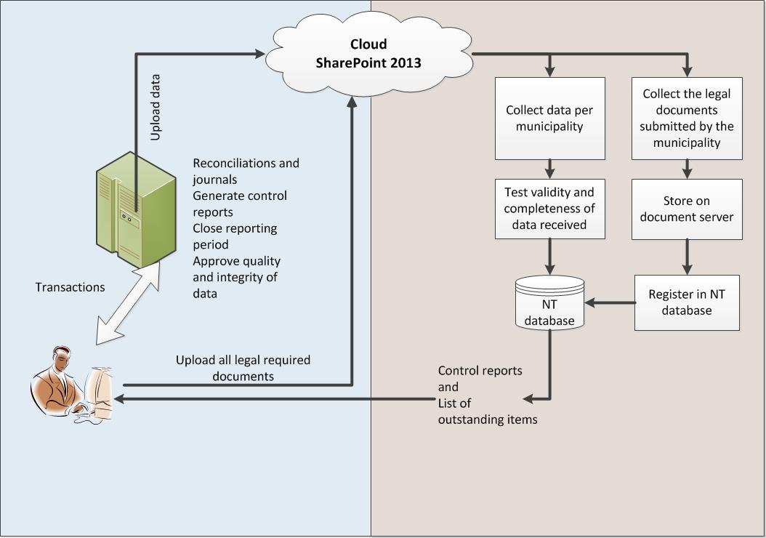
New collection method for submissions

Slide 8
Reporting requirements
Future publications
One submission per period will be allowed – NO RESTATEMENTS
Deadlines for submissions will remain the same as in MFMA and MBRR
The verification process falls away as it is now the responsibility of the municipal manager to verify the correctness of the data BEFORE submission to LGDRS
For audit purposes the MM and CFO will sign-off on reports produced in the MBRR Schedule formats directly out of their financial system and will keep such records per period
On receipt of the financial datasets, NT / PT will reproduce the MBRR schedules based on the financial datasets received per municipality
These schedules will be circulated back to the municipality as control reports and must be checked against the signed scheduled produced by the municipality

Slide 9
Running different versions of mSCOA

Slide 10
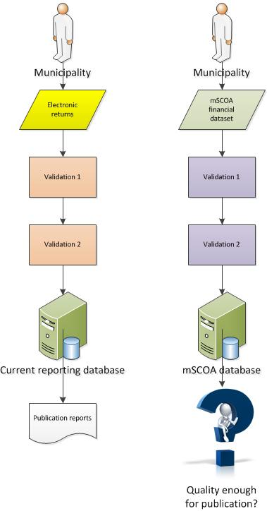
Two separate databases

Slide 11
Producing publications
For all publications the LGDRS will be the source
The current reporting database will remain in place and will remain functional until the mSCOA reporting is of good enough quality to become the main source of information
Therefore the Appendix B returns must still be submitted until the vendors are able to prepare mSCOA submissions that pass the validation tests
The switch over will be done FOR ALL at the beginning of a financial year WHEN ALL ARE ON THE SAME LEVEL
The MBRR schedules will be used as the benchmark:
Compare A1/C schedule based on Appendix B returns
To
A1 / C Schedule based on mSCOA database
To
Signed schedule at municipality

Slide 12
The way forward
REMEMBER that the MBRR reporting requirements for the different schedules is still required. VERIFICATION will be done by the municipality using these formats!!
Ensure that reporting on a financial year is concluded in the same version. Validation of submissions will be linked to the version prescribe for that financial year.
Register of approved amendments on website and circulated
Produce new version of XML

Slide 13
THANK YOU

