Slide 1
mSCOA Version 6.2 Change Requests
Presented by National Treasury: 2 November 2018

Slide 2
ITEM SEGMENT

Slide 3
Item Revenue: Transfers and subsidies
National grants not split between operating and capital; and
National and Provincial grants not available (retired) on the chart for transacting.
Proposed solution: National Treasury will still provide break down for National grants. The provincial grants will be breakdown required, where the municipalities will provide names of the grants.

Slide 4
DoRA Grant structure
Direct transfers
Infrastructure
Municipal infrastructure grant
Water services infrastructure grant
Urban settlements development grant
Integrated national electrification programme (municipal) grant
Public transport network grant
Neighbourhood development partnership grant (capital)
Integrated city development grant
Rural roads asset management systems grant
Metro informal settlements partnership grant
Regional bulk infrastructure grant
Municipal disaster recovery grant

Slide 5
DoRA Grant structure
Current
Local government financial management grant
Municipal demarcation transition grant
Expanded public works programme integrated grant for municipalities
Infrastructure skills development grant
Energy efficiency and demand-side management grant
Municipal disaster relief grant
Municipal rehabilitation grant
Municipal emergency housing grant
Municipal systems improvement grant

Slide 6
DoRA Grant structure
Indirect transfers
Infrastructure
Integrated national electrification programme (eskom) grant
Neighbourhood development partnership grant (technical assistance)
Regional bulk infrastructure grant
Water services infrastructure grant
Bucket eradication grant
Current
Municipal systems improvement grant

Slide 7
Provincial grant proposed structure
Province
Infrastructure (breakdown required and used in conjunction with FX)
Specify grant
.
.
Specify grant
Capacity and other (breakdown required and used in conjunction with FX)
Specify grant
.
.
Specify grant

Slide 8
Item Revenue: Transfers and subsidies
Kindly add Vodacom as entity (Revenue item GUID: 2dd9109a-6920-4b94-a4ae-61f7833bd680 ) and change posting level indicator to "Yes"
Subsidies from private enterprises will be breakdown required, where the municipalities will provide names.

Slide 9
Item revenue: property rates
The Revenue and Debtors Categories for Property Rates is based on the type of property instead of the use. There is currently no requirement that says the valuation roll or the property register under the MPRA should have both the use and the zoning, further to this if a municipality raise rates on the use then the zoning will not be classified according to s8(2) of the MPRA.
Proposed solution: Property rates categories to be aligned to MPRA.

Slide 10
Item gains and losses: Impairment
The high-level structure for impairment / reversal of impairment / gains and disposal in the Item Segment: Gains and Losses must align to Depreciation and Amortization
Proposed solution: Align the structure to depreciation and amortisation

Slide 11
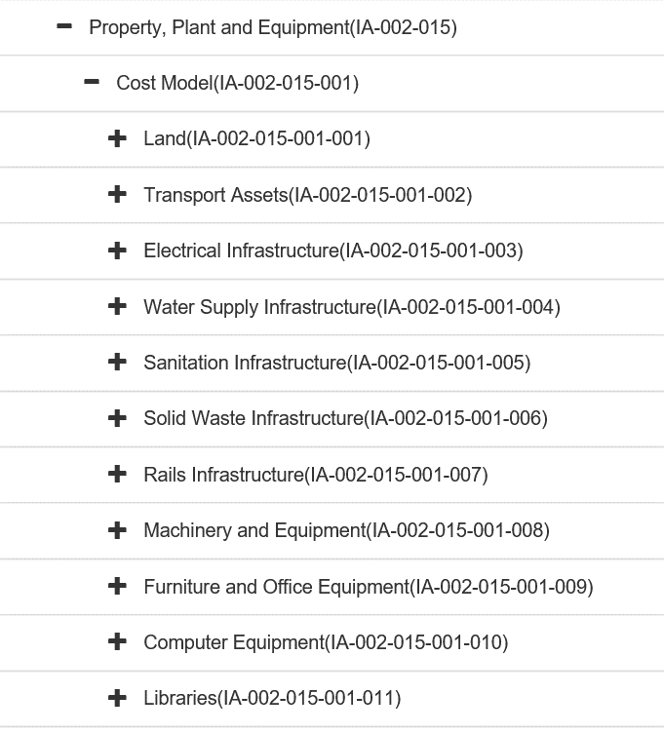
Item assets: asset class
Libraries classification to be deleted throughout the asset classification as this category is duplicated and included in community assets as per CIDMS Framework. Segments: Assets, Expenditure, Gains and Losses and Project

Slide 12
Item revenue: Sale of goods
Add the Fresh farm products (Fresh Produce). - Add a separate line item for fresh produce.

Slide 13
Item expenditure
Item Expenditure: Correct the spelling of Eskom. Currently spelled "ESCOM“

Slide 14
Item Assets: Construction Work in progress
Construction Work-In-Progress. #No transfer out account to move to a completed asset. When an asset is completed from work in progress to a finished asset. There should be a transfer from WIP to the completed class of asset. Version 6.1 and version 6.2 does not accommodate for this. This must be considered in version 6.3 and also municipalities to advise where should this currently be posted to allow for the transfer
Proposed solution: create a line item to transfer from WIP to completed asset.

Slide 15
Item assets: Construction Work in progress
WIP is an asset as defined in GRAP 17. WIP relating to PPE is included as part of the carrying of PPE (par. 87 of GRAP 17) and the municipality is required to disclose the reconciliation of the carrying amount required in par. 85 (e) of GRAP 17. i.e. Show the following separately in the notes: Additions, disposals, impairment loss, Impairment loss reversals, other changes. There should be a Guid available on the chart for each of these movements to ensure that the GRAP required information is available. Same applies for GRAP 16 Investment Property.
Proposed solution: for reporting purposes breakdown must be provided. How can municipalities achieve this through using the project segment: capital projects?

Slide 16
Item assets: PPE/ Land
Change definition for General Plant to be the same as in the ASB guideline.

Slide 17
FUNCTION SEGMENT

Slide 18
Finance
What is the difference between Budget and Treasury Office and Finance on the Function Segment?
'Budget and Treasury Office' is a
duplication 'Finance' . Delete
‘Budget and Treasury Office’

Slide 19
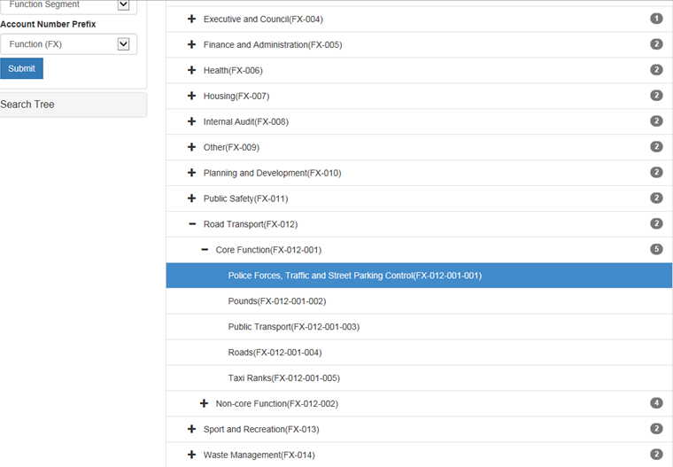
Transport
Police forces, traffic and street parking included under Road Transport instead of public safety. Proposed solution: include as public safety.

Slide 20
REGION SEGMENT

Slide 21
Region Segment Change Requests
Close all region accounts where municipalities seize to exist after demarcation changes;
Municipality duplicated;
The municipalities under DC36 and DC30 are swopped around; and
Add regions as requested.
Proposed solution: accommodate the requests.

Slide 22
Questions

