Slide 1
System to system reporting and Accountability
Presenter: Elsabé Rossouw| Director, Local Government Data Management | 8 February 2019

Slide 2
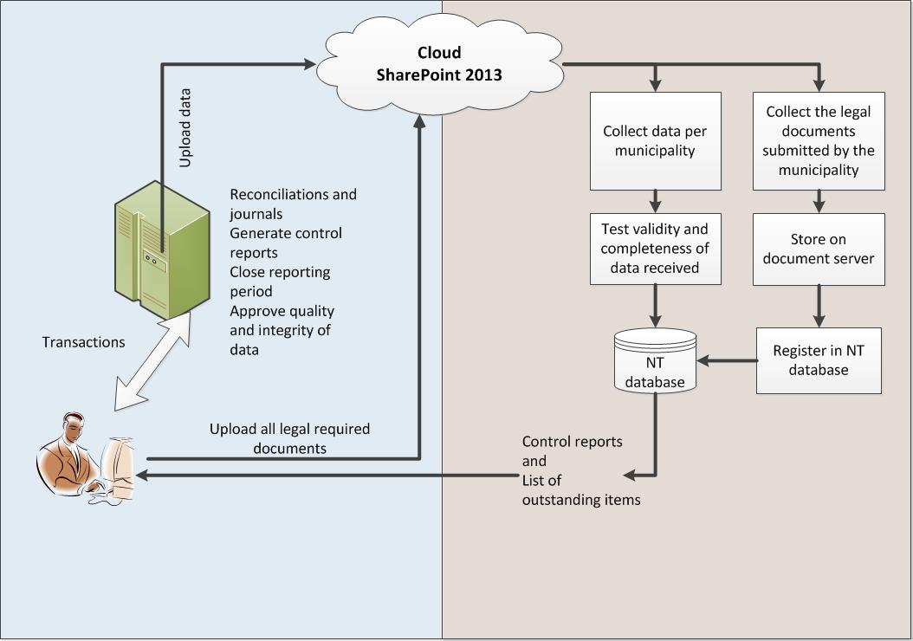
SharePoint collection method for submissions

Slide 3
Duplication of contacts
LGDRS
SharePoint

Slide 4
Reliability of data strings
Correction of errors outside of the financial system in text file
Reconciliations and check and balances not done
Reporting periods not closed before reporting
MM and CFO have no idea what is being submitted – schedules are not produced out of the financial system
Submissions by users long gone from the municipality
No detail drill down available to investigate detail records

Slide 5
Moving towards system to system communication
Technology
Municipality
LGDRS
Accountability
Responsibility
Timeous reporting
Audit evidence
Technical environment
Receipt of submissions
Register of receipts
Feedback to municipalities
Control reports
Locking of reported periods

Slide 6
How are we going to achieve this?
At National Treasury
WebFOCUS open portal
Unlimited users access
Security profiles
Municipality
Provincial Treasuries
External users
Public user
Change collection method from SharePoint to WebFOCUS open portal
Use SFTP and MD5 hash
Push methodology from municipality
Notes:
What is an MD5 hash?
An MD5 hash is created by taking a string of an any length and encoding it into a 128-bit fingerprint. Encoding the same string using the MD5 algorithm will always result in the same 128-bit hash output. MD5 hashes are commonly used with smaller strings when storing passwords, credit card numbers or other sensitive data in databases such as the popular MySQL. This tool provides a quick and easy way to encode an MD5 hash from a simple string of up to 256 characters in length.
MD5 hashes are also used to ensure the data integrity of files. Because the MD5 hash algorithm always produces the same output for the same given input, users can compare a hash of the source file with a newly created hash of the destination file to check that it is intact and unmodified.
An MD5 hash is NOT encryption. It is simply a fingerprint of the given input. However, it is a one-way transaction and as such it is almost impossible to reverse engineer an MD5 hash to retrieve the original string.

Slide 7
How are we going to achieve this?
At the municipality
Reconciliations and management reports (also MBRR Schedules) through dashboards
Close reporting period and print audit evidence
MBRR Schedules directly from financial system
MM gives green light
Financial system push data string using SFTP and MD5 hash
Monitoring progress by municipality
Municipality will access WebFOCUS open portal
Will track submission and processing
Will be allowed to draw their own reports to check against audit evidence
Notes:
What is an MD5 hash?
An MD5 hash is created by taking a string of an any length and encoding it into a 128-bit fingerprint. Encoding the same string using the MD5 algorithm will always result in the same 128-bit hash output. MD5 hashes are commonly used with smaller strings when storing passwords, credit card numbers or other sensitive data in databases such as the popular MySQL. This tool provides a quick and easy way to encode an MD5 hash from a simple string of up to 256 characters in length.
MD5 hashes are also used to ensure the data integrity of files. Because the MD5 hash algorithm always produces the same output for the same given input, users can compare a hash of the source file with a newly created hash of the destination file to check that it is intact and unmodified.
An MD5 hash is NOT encryption. It is simply a fingerprint of the given input. However, it is a one-way transaction and as such it is almost impossible to reverse engineer an MD5 hash to retrieve the original string.

Slide 8
How are we going to achieve this?
The NT environment has been prepared
Pilot has been run with the help of a volunteer vendor
Success achieved
We are now stuck in the NT:SCM environment to procure the software needed
Once we have the software in place AND a contract for 3-years to manage the renewal of the licenses, we will call a Technical meeting where we will speak “tech” on the detail
Notes:
What is an MD5 hash?
An MD5 hash is created by taking a string of an any length and encoding it into a 128-bit fingerprint. Encoding the same string using the MD5 algorithm will always result in the same 128-bit hash output. MD5 hashes are commonly used with smaller strings when storing passwords, credit card numbers or other sensitive data in databases such as the popular MySQL. This tool provides a quick and easy way to encode an MD5 hash from a simple string of up to 256 characters in length.
MD5 hashes are also used to ensure the data integrity of files. Because the MD5 hash algorithm always produces the same output for the same given input, users can compare a hash of the source file with a newly created hash of the destination file to check that it is intact and unmodified.
An MD5 hash is NOT encryption. It is simply a fingerprint of the given input. However, it is a one-way transaction and as such it is almost impossible to reverse engineer an MD5 hash to retrieve the original string.

Slide 9
Summary
Pushing the envelope towards system to system communication
Dashboards as vehicle to
Enforce accountability
Better reconciliations
Keeping the system and sub-systems in balance
Promote integrated approach
Taking mSCOA to all levels – organisational reform
Assist with change management

Slide 10
Thank you
Notes:
10

