Slide 1
mSCOA Version 6.3 Change Requests
Presented by National Treasury: 25 September 2019

Slide 2
mSCOA version 6.3 Chart Changes Requests
Various stakeholders registered chart change requests on the mSCOA FAQ portal.
These change requests were analysed by the FAQ Team to determine chart changes with merit.
The first group of these chart changes requests will be presented to the Technical Working Committee in this meeting for approval or referral to the Steering Committee (Technical Committee) meeting on 10 October 2019.

Slide 3
Proposed Chart Changes

Slide 4
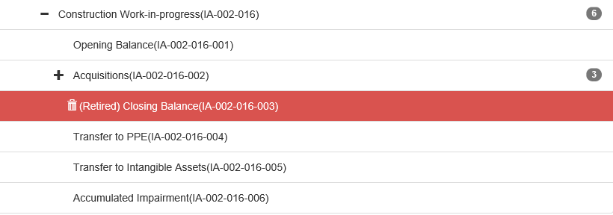
Item Assets
8869: No provision is made for the transfer of completed Work-in-Progress to Investment Property and Heritage Assets.
Solution: Add the following items “Transfer to Investment property” and “Transfer to Heritage assets”.

Slide 5
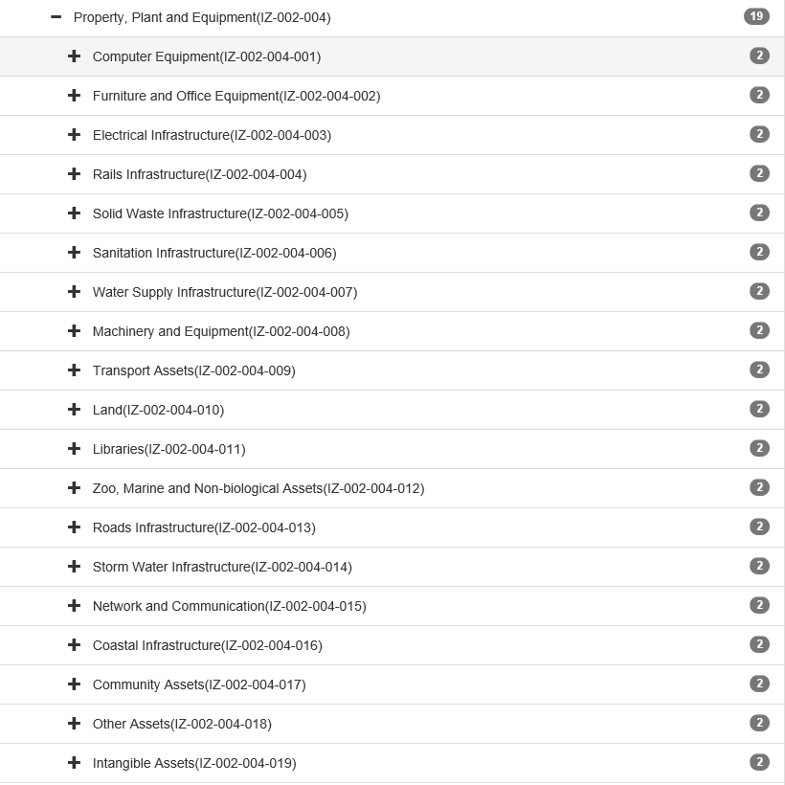
Item Gains and Losses
8870: On Item for Gains and Losses: Intangible assets cannot be classified below PPE. PPE and Intangible assets should be at the same reporting level.
Solution: Retire intangible assets from a level below PPE and create it at the same level as PPE as it is a separate asset category.

Slide 6
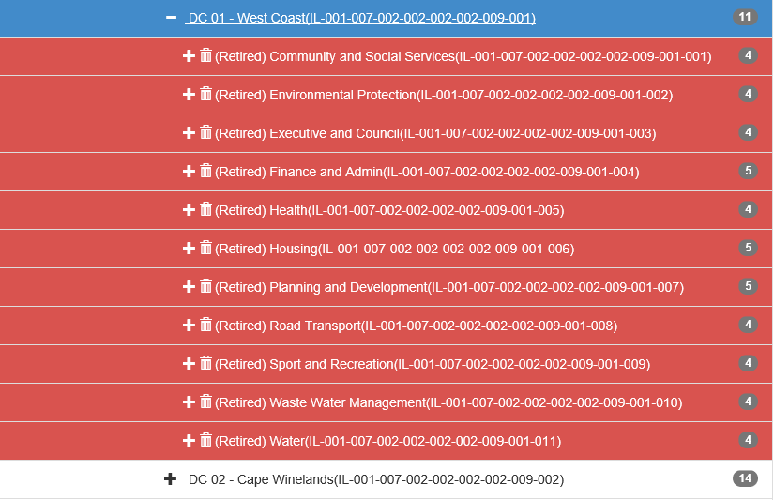
Item Liabilities
8875: Unspent Transfers and Subsidies Operational Monetary Allocations District Municipalities. DC01 Westcoast - accounts from 6.2 changed to non-posting. No posting levels for this DM in Version 6.3. Exclude new classification introduced for Version 6.3.
Solution: Create “Infrastructure” and “Capacity building and other” items in the structure for DC 01.

Slide 7
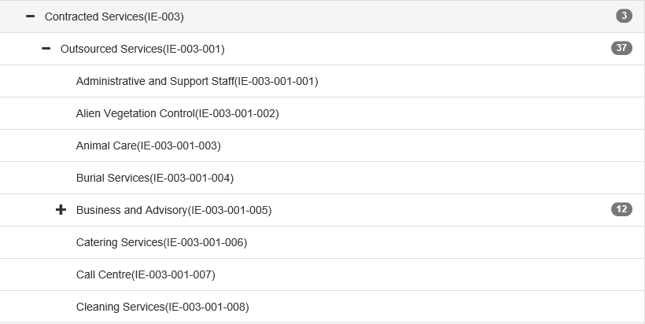
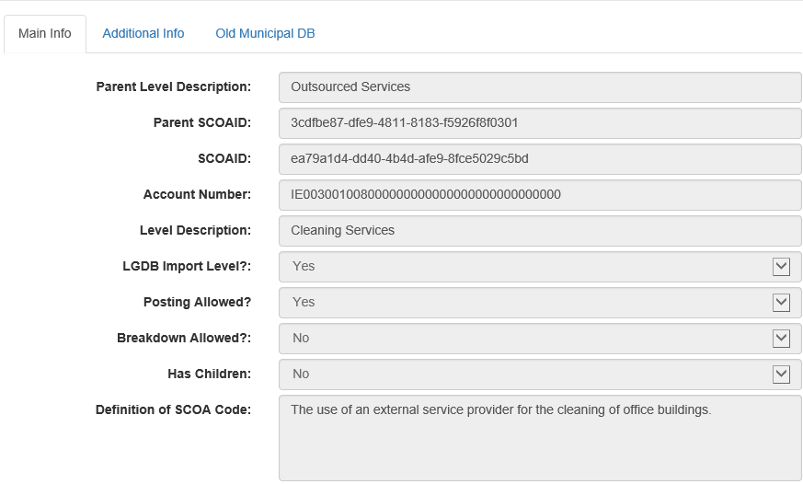
Item Expenditure
8893: Langeberg Municipality requires a new item to be created for [Item Expenditure: Contracted Services: Outsourced Services: Cleaning Public Toilets] with the following definition: If the municipality makes use of external service providers for assisting in the cleaning and maintaining of hygiene in public toilets the cost needs to be recorded to this item.
Solution: Expand definition to "The use of an external provider for cleaning of any municipal facilities”.

Slide 8
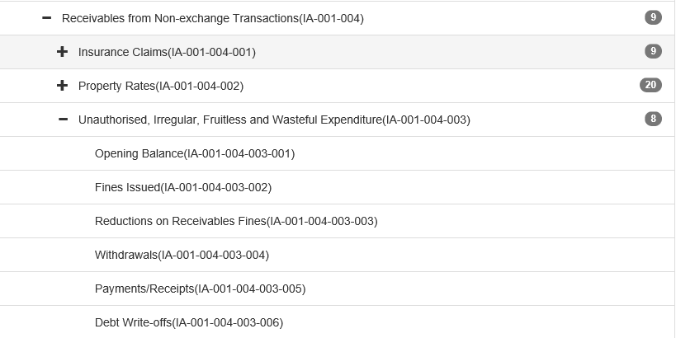
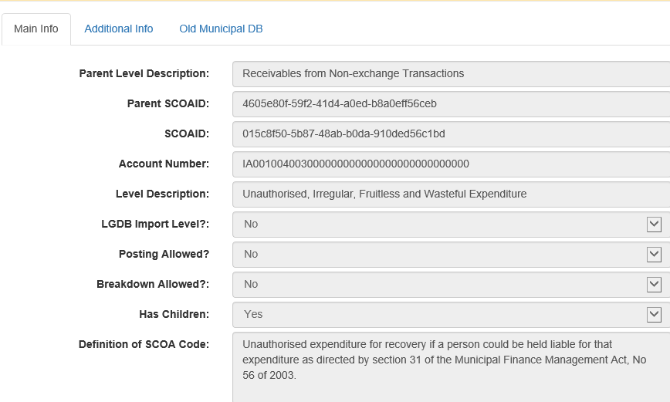
Item Assets
8902: The Item Assets of mSCOA segment detail version 6.3 provided for the recording of recoverable unauthorised, irregular or fruitless and wasteful expenditure as follows: The definitions for the Guids above do not make provision of recoverable losses deliberately or negligently incurred by the Accounting Officer or Chief Financial Officer or Senior Managers or Other Officials.

Slide 9
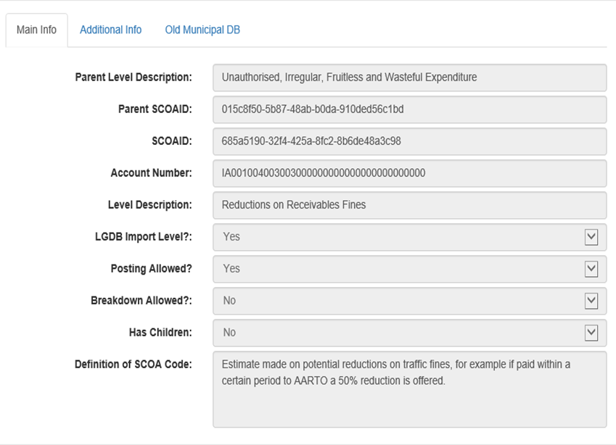
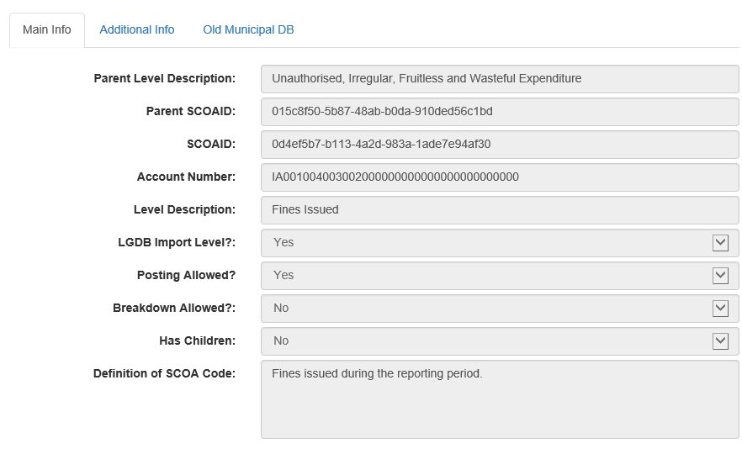
Item Assets (8902 cont…)
Solution: (a) Amend the definition of unauthorised, irregular, fruitless and wasteful expenditure to refer to section 32 of the MFMA instead of section 31.
(b) Amend definition for “reductions on receivables fines not to refer to traffic fines. It can be “Losses deliberately or negligently incurred by the Accounting Officer or Chief Financial Officer or Senior Managers or Other Officials of the municipality”.

Slide 10
Item Assets
8903: Refer to lines 2484 to 2606 on ITEM Assets on version 6.2 and carried over to version 6.3. Definitions are repeated on several lines. Example: “Assets:Current Assets:Trade and other Receivables from Exchange Transactions:Prepayments and Advances:Insurance:Opening Balance” – The definition reads “Opening balance from prior period pertaining to Trade Services Debtors: Electricity. This is not correct, as it the item relates to Insurance advances and not Electricity. The same applies to the Monthly Billing, Interest Charge, Prior Period Corrections and Recognised, Collections and Debt Write-off definitions. The error on the definitions continues on Interest, Rent, Recoveries from Staff, Subsistence and Travel, Taxes and Levies other than Income Tax, Annual Licence Fees, Subscriptions and Maintenance Contracts.
Solution: Amend the definition for prepayments and advances for opening balances on Insurance, Interest, Rent, Recoveries from Staff, Subsistence and Travel, Taxes and Levies other than Income Tax, Annual Licence Fees, Subscriptions and Maintenance Contracts.

Slide 11
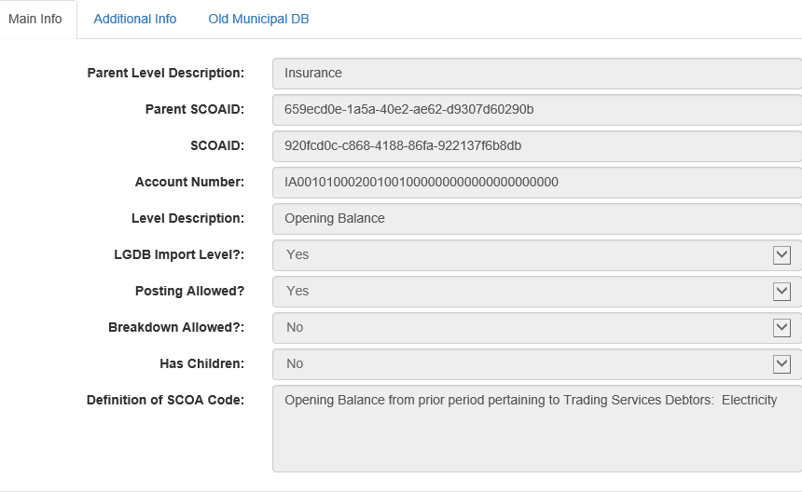
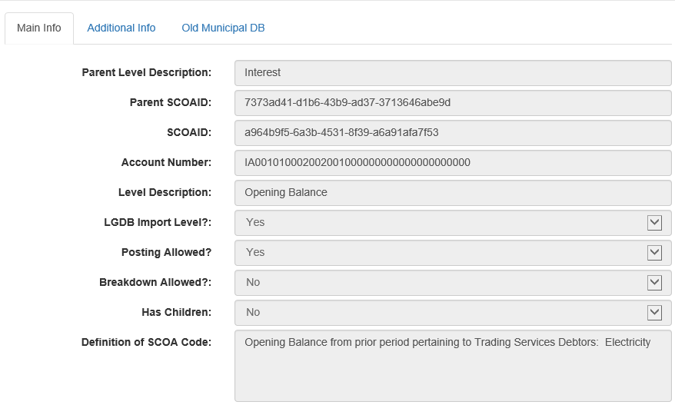
Item Assets (8903 cont…)

Slide 12
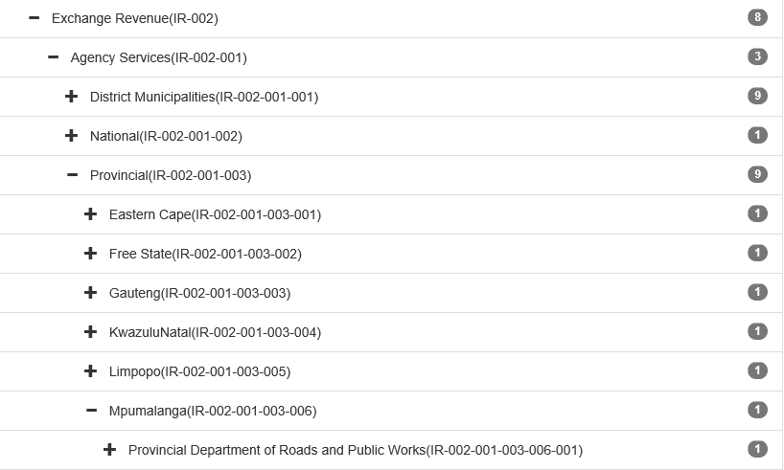
Item Revenue
8916: Municipalities in Mpumalanga are agents for the Department of Safety and Security with the license fees, etc. and not the Department of Public Works, Roads and Transport as is currently the case on the mSCOA.
Solution: Change the name to be “Provincial Department of Safety and Security”.

Slide 13
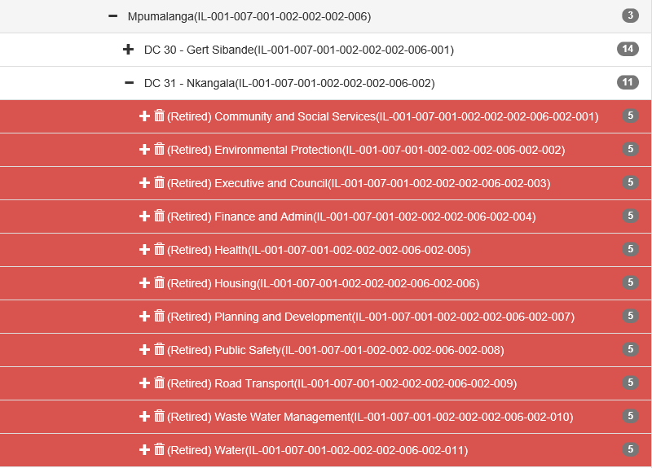
Item Liabilities
8935: New Posting Levels as per V6.3 not provided for: DC 31 - Nkangala c6b2e425-7e61-42c8-8cc8-cd9b8d3b406b Transfers and Subsidies / Payables
Solution: Create “Infrastructure” and “Capacity building and other” items in the structure for DC 31.

Slide 14
OAG CONSULTATION

Slide 15
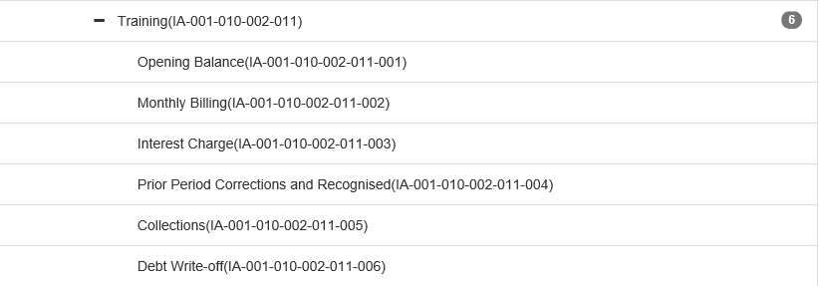
Item Assets
8876: Add Impairment Accounts for Current Assets Trade and other Receivables from Exchange Transactions / Prepayments and Advance / Training
Solution: Impairment of prepayments on training is bad practice, the municipality must recover the money from the service provider. Since it is bad practice, debt write off under training must be removed from the chart.

Slide 16
Item Liabilities
8941 & 8880: Add a Current Liabilities Payables and Accruals for Guarantees. This is different to "Retention Fees". Contractors maybe required to provide a guarantee in monetary value to the municipality to secure delivery of critical risk areas within a specified time. This is money received by the municipality that should be retained for refunding thee contractor at completion either completing the project. Retention Fees is an amount withhold from the payments made to the contractor for the successful commissioning of the project.
Solution: In accordance to GRAP Standard 19 and 9; A retention is an amount withheld by a municipality at the inception of a contract at which will be realised by the contractor at the completion and the issuing of a certificate of completion by a registered quantity surveyor. A guarantee is a formal pledge or assurance (typically in writing) that certain conditions will be fulfilled, especially that a product will be repaired or replaced if not of a specified quality and durability. A guarantee in the books of the municipality will be initially recognised as a contingent asset. Therefore the transaction would constitute a provision and cannot be transacted on the system but will be disclosed on the notes of the financial statements. In conclusion a line item is not required for guarantees.

Slide 17
Consolidation
8881 & 8883:Consolidation elimination guidelines are required to ensure that consolidated reporting is correct at a control entity level.
Solution: OAG to confirm whether a consolidation guideline exists that can be shared with municipalities.
LGBA must include consolidation in the budget and transacting training module.

Slide 18
VAT Treatment on retention
8884 & 8885:Our clients does not tread the VAT on retention fees consistent and expect provision in the system for options. Please refer to the attached and advise on the interpretation and position taken by NT/OAG on the subject matter.
Solution: No changes to the chart required. Retention should be raised as a trade and other payable(e.g. accrue VAT) upon inception of a contract. This is aligned to GRAP and SCM guidelines.

Slide 19
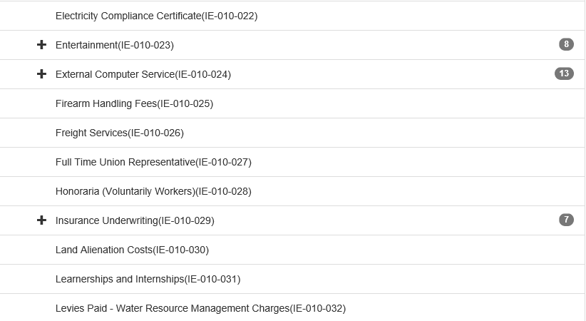
Item expenditure
8894:Langeberg Municipality requires a new item to be created for [Item Expenditure: Operational Cost: Environmental Permits] with the following definition: Acquiring an annual permit from Department of Environmental Affairs for alien invader plant species (plants or trees) to be permitted to remain on municipal property.
Solution: Check the treatment on the National SCOA. If there is no item available to be used, amend the chart to include the proposed item.

Slide 20
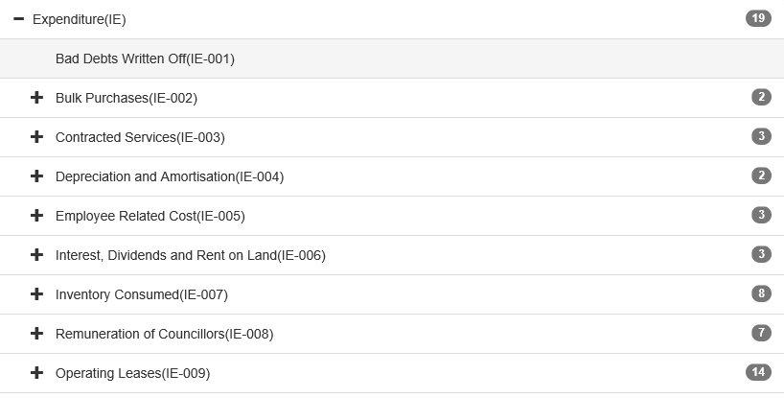
Operating Lease
8944:Please check new GRAP standards Operating Lease shouldn't be part of the SOFP(P/L).
Solution: Retire the line for operating lease on the chart to align to the amended GRAP 13.

Slide 21
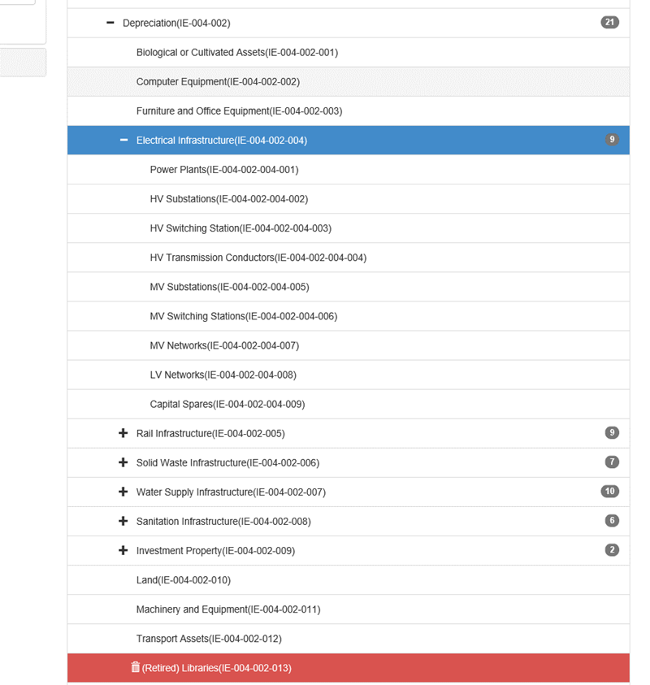
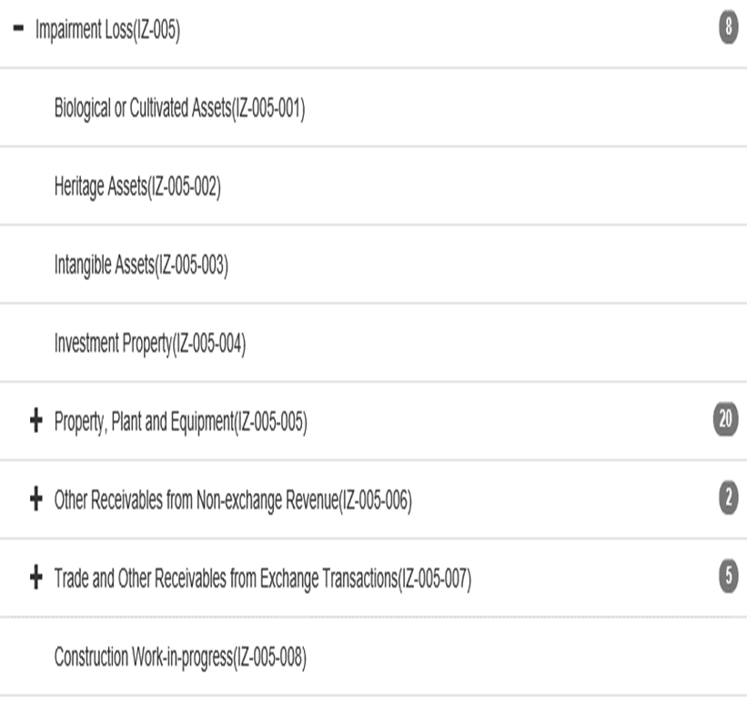
Item Gains and Losses
8940:Add the posting level structure added for "depreciation" to "Impairment and Reversal of Impairment" in the Item Segment Gains and Losses
Solution: Align the posting level structure to be same for "Depreciation", "Impairment loss" and "Reversal of Impairment loss". (Should the structures be same or impairment can be done at an asset class level?)

Slide 22
AFS SPECIMEN

Slide 23
Amendments to be done to specimen
8917: Where should values under Unallocated deposits be added to the mSCOA illustrative?
8921: Illustrative AFS refers to Trade and other payables. It should be named the same as mSCOA Trade and other payables from exchange transactions.
8922: Illustrative AFS refers to Unspent Transfers and subsidies. It should refer to Trade and other payables from non-exchange transactions as per mSCOA. Otherwise mSCOA not all mSCOA item accounts will be included in AFS.
8923: In the illustrative AFS, the following rows are missing as they appear in the mSCOA item segment under Receivables from exchange transactions: Service charge Water and sanitation service authority Prepayments and advances R/D Cheques.
8924: Illustrative AFS is missing the following line item under Receivables from non-exchange transactions, as they mSCOA accounts included in the item segment: Accrued income.
8925: Illustrative AFS is missing the following line items under Other current assets as they are mSCOA accounts included under the item segment: Deposits Income tax receivable Operating lease Control, clearing and interface Fair value adjustments

Slide 24
Amendments to be done to the chart
8926: The following mSCOA accounts needs to be added to the item segment as they appear in the mSCOA Illustrative but is not in the item segment: Inventory|Spare parts.
8927: The following mSCOA accounts needs to be added to the item segment as they appear in the Illustrative AFS but is not in the item segment: Other current assets: Investments Other current assets: Current portion of non-current receivables (completeness and vise versa link).

Slide 25
MAPPING OF MBRR SCHEDULES

Slide 26
Cash Flow
8892: Langeberg Municipality does not understand the methodology NT uses to compile the A7 in the perfect alignment to the A schedules as per the TABB. They do not understand how NT can populate the A7 from the funding GUID for the receipts and then the Item Expenditure GUID for payments when the Balance Sheet Item Guid should be used to calculate the movement in cash and cash equivalents. please provide a detailed explanation in order for us to achieve a perfect alignment on A7 for the ORGB.
8945: We notice in the mapping table of the A7 that NT had Transfers and subsidies mapped to proceeds on Disposal of PPE- 260. We have mapped the transfers and subsidies to code 220 and not 260. Kindly verify if our mapping is correct. Hereunder an extract from the A7 mapping that is available on the portal.
8862: How can the municipality resolve the Cashflow line under "CASH FLOW FROM FINANCING ACTIVITIES, Receipts, Increase (decrease) in consumer deposits". The municipality cannot identify a funding option that can be used and therefore it cannot be resolved.
Solution: NT will issue a guideline on the revised cash flow mapping.

Slide 27
Statement of Financial Position & Performance
8891: Langeberg Municipality mapps all Receivables from Exchange transactions to Consumer debtors; and all Receivables from Non-exchange transactions to Other Debtors in A6 of the Schedule A. We strongly disagree that Property Rates should be mapped to Consumer Debtors as this is a tax and not a consumable and cannot be a consumer debtor. Once again this description of Consumer Debtor and Other debtors does not conform to the GRAP standards 9 and 23; and it will reflect variances with regards to Audited AFS and Budget as per GRAP 24. National Treasury should revisit the A6 template to conform to GRAP in terms of Exchange and Non-exchange receivables instead of Consumer Debtors and Other Debtors. (Amend the mapping for table A6 to align to the AFS specimen and GRAP 9 and 23.)
8904 - 8907 & 8890: A4 Expenditure Debt Impairment: - We see write-off of debtors as Other expenditure rather than Debt Impairment. we therefore allocated included it under other expenditure and the validation 1cf602dd-a304-41d5-ace0-b80c24672c74. otherwise the impact is Zero. This is a material amount of R54, million. (Amend the mapping for debt impairment to be informed by item gains and losses as it is not bad debts written off).

Slide 28
CHANGES TO MBRR TABLES

Slide 29
Statement of Financial Position & Performance
8901 & 8920: Currently there is no item on the SOF Position on the A/B/C Schedules to indicate the heritage assets separately. Currently the municipality disclose this on the other non current assets item in the SOF Position.
Solution: Heritage assets is disclosed separately on the AFS specimen. Consider amendments to the MBRR schedules if necessary.

Slide 30
VALIDATION RULES

Slide 31
VALIDATION RULES
8943: Please change the validation rules especially the one relating to PD. See attached highlighted rules. "Default projects may not have Item Expenditure and Assets except for current assets or non-current receivables or default items or Surplus/Deficit“. (PSD: Default transactions are the classification required to record a transaction within all the segments of the mSCOA. Revenue, assets (excluding capitalised expenditure), liabilities and net assets need to be captured to this account.
8934: Review Segment Verification rules to align to newer versions of the charts referring to PC and PD.
8898: Good morning NT Request for input regarding the use of CAPITAL PROJECT GUID + the use of segment check "Capital projects can only have Item Assets or Payables and Accruals and Retentions” versus COCT processes and Schedule reporting. Please find the attached documents explaining our scenario. Regards, Christiaan.

Slide 32
Questions

