Slide 1

mSCOA / BUDGET ANALYSIS WORKSHOP
National Treasury | Jan Hattingh 09
09 to 11 November 2016

Slide 2
Long-term objectives of LG budget reform agenda
Quality local government information informing national policy debates
Information comparable across all municipalities to aid resource allocation decisions
  Ensuring a credible budgeting process is a key ingredient to improving financial management
  Facilitate the alignment of the budget to national priorities with the aim of improving service delivery outcomes
  Over time, one should be able to draw a direct correlation between a credible budgeting and the audit outcomes
Prevention of municipal financial difficulties before they occur by through the application of budget and Section 71 analysis - an early warning system
  Must form the basis of recovery plan where difficulties/challenges are experienced
Strengthening the link between policy formulation, planning, budgeting, implementation, reporting and monitoring i.e. accountability and service delivery

Slide 3
Envisaged impact to the local government sphere
Prevention of municipal difficulties before they occur through the application of budget and section 71 analysis
All efforts must be the improvement between policy formulation, planning, budgeting, implementation, reporting and monitoring
Ensuring a credible budgeting process as a key ingredient to improving financial management
Information comparable across all municipalities to aid resource allocation decisions
Quality local government information informing national policy debates

Slide 4
In summary:
What have we done to date ……
Development and implementation of a budgeting system for LG
Development and implementation of a LG reporting system – including the establishment of the LG Database which provides for a ‘early warning system’
Development and implementation of a LG grant monitoring and management system
Routine publication of municipal performance in various forms
Issuing of key regulations
  Municipal Standard Chart of Accounts (April 2014)
  Municipal Budget and Reporting Regulations (April 2009)
Research and development of a Uniform System Solution for LG
  Issued the Integrated Financial Management Transversal Tender on the 04 March 2016
  Issued MFMA Circular No.80 on Municipal Financial Systems and Business Processes on the 08 March 2016
  Announced the name of successful companies (seven) on 02 August 2016:
    Press Release as approved by DG and communications
    mSCOA Circular No. 6
    Release of mSCOA Version 6
Research and development of LG revenue management initiatives to improve billing and revenue collection
Research and development of financial modelling in municipalities by focusing on costing, tariff determination and cost benefit analyses for capital project
Cross Cutting Activities
  Continuous stakeholder management with various stakeholders such as IMFO, NERSA, DWA etc.
  Continuous training, development and capacitating of all stakeholders such as municipalities, councillors, DWA, SALGA etc.

Slide 5
LGBA has been building a strong foundation for effective management of LG finances
  Initial focus on improving legal compliance with budgeting and reporting requirements among the 17 non-delegated municipalities (71% of LG expenditure)
    Timeliness, quality and comparability of fin info
  Now strengthening oversight capacity of provincial treasuries for delegated municipalities:
    Strategy to Address Local Government Performance Failures (TCF and BC in ‘09 & ’14)
    Differentiated Approach to Support Provinces to Address LG Performance Failures (TCF & BC in July / Aug ‘14)
    BC resolution that NT and PTs will collectively focus their efforts on the game changers for next period (i.e. funded budgets, revenue management, mSCOA, asset management and SCM)

Slide 6
…. in a systematic way
2006
First publication of the S71 reports covered only 43 municipalities complied during the Q3 of the 2006/07 FY
2008
S71 compliance improved and by the Q4 2008/09 FY all 283 municipalities were compliant
Introduction of mid-year budget and performance engagements for the 17 non-delegated municipalities (Section 72 of the MFMA)
2009
Introduction of the Budget and Benchmark Engagements for the 17 non-delegated municipalities (Section 18 of the MFMA)
Promulgation of the Municipal Budget and Reporting Regulations (MBRR)
2010
Training and support for the implementation of the MBRR
2011
Significant improvement in the compilation and credibility of S71 reports
2014 to 2017
Issued Regulations for mSCOA and implementation
Implement mSCOA Phase 4 - change management and piloting
  These processes have improved the quality of municipal financial information reported and provided a platform whereby sector departments are able to constructively engage municipalities

Slide 7
… with extensive support to provincial treasuries in monitoring and oversight
  Training PT officials on the municipal budget formats and budget assessment methodology to ensure credible, funded and sustainable budgets – number of funded budget have improved from 174 in 2013/14 to 189 in 2015/16
  Supporting the PTs mid-year municipal visits and the annual budget assessment and benchmark engagements to ensure alignment to NTs processes
  Training PT officials on how to utilise NT’s LG database for in-year monitoring and analysis of S71 reports
  Assist PTs to compile credible strategies to address LG financial performance failures that are aligned to the game changers
  Appoint advisors through MFIP II in NC, LP, EC and GP Treasuries (advisors for remaining provinces still to be appointed) with the implementation of their strategies. Advisors for NC and LP has resigned on 31 July and August respectively. In addition, appointed six mSCOA Advisors
  Appointed MFIPII advisors in selected municipalities to assist them to address / strengthen institutional and municipal finance management weaknesses
  Introduced municipal revenue value chain and integrated approach to PTs to provide insights into revenue management challenges. Established working group to design revenue management programme and identify pilot projects to be implemented
  Training for and guidance on mSCOA readiness and implementation

Slide 8
Outcome of the 2016/17 MTREF Budget Verification

Slide 9
Background and objectives
October each year NT publishes a consolidated set of budget information for all municipalities
Why do we do this?
  To compile a credible baseline for the monitoring of in-year performance through the S71 reporting process
  To inform the Medium Term Budget Policy Statement (MTBPS)
  To inform reporting to Parliament and key policy funding decisions
  To inform the analysis conducted by external stakeholders such as the Reserve Bank, credit rating companies, financial institutions, etc.
Therefore the credibility of the information is of critical importance
This means that the information in the following documents must reconcile
1
2
3
4
Budget adopted by council with a resolution
Electronic A1 schedules submitted to NT
Budget return forms submitted to LG database
Audited outcomes align to audited AFS

Slide 10
Budget verification progress – 02 November 2016

Slide 11
Where does mSCOA fit in?

Slide 12
mSCOA in the broader FM landscape
mSCOA
mSCOA represents the detailed, or posting-level, accounts which financial practitioners would use to capture transactions in the financial systems. The mSCOA data structure is then used to compile both budgets and financial statements.
Budgets and actual financial transactions are captured in the municipality’s financial system, across all of the segments of mSCOA; facilitating a direct comparison of budget versus actual spending.

Slide 13

What Segments are Required in mSCOA and where do they come from?
Municipal Standard Classification: MSC is a non regulated segment and will probably still represent the MFMA vote.
Project: DCOG This segment is to ensure that all projects in the IDP is aligned to budgets.
Function: Here we align with the IMF, GFS, Constitution and Municipal Structures act to “Departments and Votes”
Costing: Management Accountants / Tariff modelling . The PSD acknowledge a gradual approach I.E Administrative functions to Commercial services will suffice.
Item: ASB / OAG This is the Accountants segment and is informed by GRAP, IFRS and accounting standards. All financial reporting and reconciliations happen in this segment.
Region: Communities need to feel and see delivery, Only through planning and physical delivery can this be communicated effectively.
Fund: Budget Office National and Provincial Government are on Modified cash and Local government “Item are on Accrual” Here we align to Payments and receipts and in essence achieve cash flow here.

Slide 14
Municipal Money and
Financial Management Reforms

Slide 15
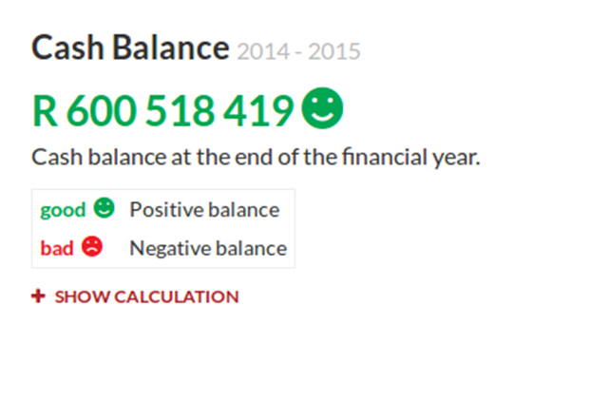
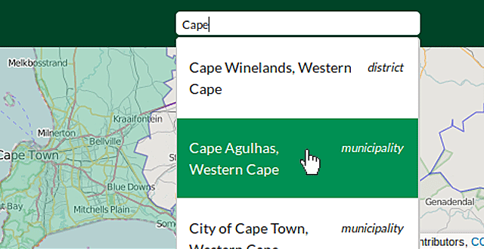
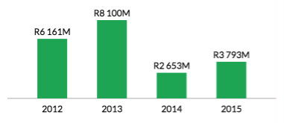
“Municipal Money” Website
SALGA welcomed the Minister of Finance’s announcement of the launch of the “Municipal Money” website. MPs asked several questions about the accessibility and accuracy of the data on the site

Slide 16
Broad Observations
Background of Municipal Money
In the 2016 Budget Speech the Minister of Finance said:
  “This year brings our fourth fully democratic local government elections. In recognition of this, the National Treasury will launch a data portal to provide all stakeholders with comparable, verified information on municipal financial and non-financial performance. I hope this will further stimulate citizen involvement in local governance.”
www.municipalmoney.gov.za went live on 26 October 2016
Government budgets are a blueprint for how public resources are going to be spent and budget information should be transparent and accessible for people to understand how public funds will be used
National Treasury is a founding member of the Open Government Partnership which strives for transparency and informed public participation in government processes

Slide 17
Content of Municipal Money
Data accuracy
Data is up to date and is based on the submissions of municipalities to the Local Government Database and Reporting System (Local Government Database and Reporting System). It is based on the quarterly Section 71 publications and the latest audit outcomes
Municipal Money will be updated every quarter with the latest available finance data
Accessibility
Information is available 24/7 on internet and mobile devices
It is educational and explains finances in “citizen-speak”
It has links to the guidance on how to interpret the data
It encourages and guides citizens on how they can get involved in the Budget and Planning cycle of the municipality
It accommodates feedback mail for queries or general comments and collects statistics on the use of the open portal

Slide 18
Future refinements to Municipal Money
National Treasury is committed to working with stakeholders to continuously improve the website
6125 people have already used the website
Enhancements have already been requested:
  Better comparative measures on tariffs and household bills
  Tracking of capital projects of municipalities
  Ward based data
The Project Steering Committee will meet at the end of this month to discuss new focus areas based on feedback from citizens

Slide 19
Local Government Accountability Cycle
Standard Chart of Accounts
Improved Service Delivery
IDP
Budget
SDBIP
IYR
AFS
Annual Report
5 Year Strategy
3 Year Budget
Annual Plan to Implement
Monitoring & Council Oversight
Oversight
BEPP
Spatial transformation plan & process
The IDP determines the strategy, objectives and service delivery targets for the municipality
mSCOA, creates the environment to enable the execution of the accountability cycle, from IDP to Annual Report
mSCOA , if well implemented and managed, after future phases have been completed, will provide direct evidence in dashboard format, of the achievement of IDP strategy, objectives and service delivery targets in the municipality
Greatly limits greatly unauthorised expenditure.

Slide 20
THANK YOU

