Slide 1
mSCOA Workshop: Building capacity to sustain mSCOA….Training

Slide 2
CHANGE AND TRANSITION:
Embedding change in your head, heart and hand

Slide 3
WHAT IS REQUIRED?
mSCOA Classification framework -
Revenue
Supply chain
Assets
Performance
Project Management
Risk Registers
New system
Performance Management

Slide 4
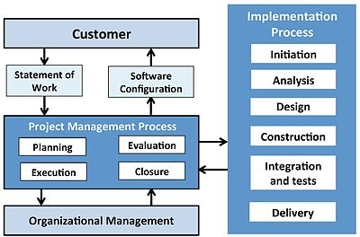
HOW CAN WE DO THIS?

Slide 5
CAPACITY BUILDING:
Hand
Holding
Theory
System

Slide 6
TRAINING PLAN:
National mSCOA Workshops - March
May
September
2. Theory Topics - mSCOA Budget Preparation
Performance Management
Basic Accounting
Audit and Risk
MPRA
Supply Chain Management
Mass Appraisal Techniques
GIS Property Management
Revenue Management
Asset Management

Slide 7
TRAINING ROLL OUT:
System training – Vendors
Hand holding – Vendors
Accredited mSCOA training - CIGFARO
mSCOA theory training – National Treasury
CIGFARO

Slide 8
Thank you
for the opportunity
to discuss training
with you

