Slide 1

Budgeting in mSCOA

Slide 2
Legislative framework that enable financial management
Municipal Systems Act, 2000
“Adoption of integrated development plans
25. (1) Each municipal council must, within a prescribed period after the start of its elected term, adopt a single, inclusive and strategic plan for the development of the municipality which:
links, integrates and co-ordinates plans and takes into account proposals for the development of the municipality;
aligns the resources and capacity of the municipality with the implementation of the plan;
forms the policy framework and general basis on which annual budgets must be based;”
MFMA, 2003
“Budget preparation process
21. (1) The mayor of a municipality must – (a) co-ordinate the processes for preparing the annual budget and for reviewing the municipality’s integrated development plan and budget-related policies to ensure that the tabled budget and any revisions of the integrated development plan and budget-related policies are mutually consistent and credible;”
,

Slide 3
The Integrated Development Plan - IDP
IDP
KPA
Strategic Objectives
BUDGET
3 year annualised planned expenditure
Budget plan based on IDP strategic objectives
SDBIP
Annual implementation of budget based on available funds
Performance management of budget
GFS Function
KPI
Regional
mSCOA Projects
IDP strategic objectives linked to projects
Budget vote expanded into different items

Slide 4
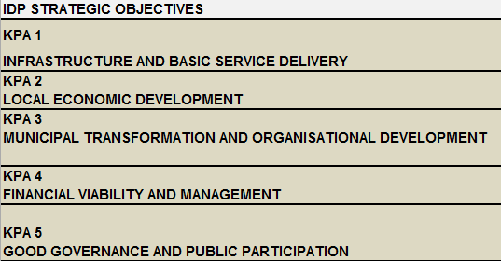
Five Key Performance Areas
Metros & Secondary Cities - also participate in a KPA for spatial development

Slide 5

UNPACKING THE IDP
One of the approaches entails utilising the following source documents to identify projects:
IDP – Already lists Capital and some operational projects
TB – Historically some projects on the TB were transacted as items
Budget – Will give an indication of any additional projects not included in the projects list. SA 36 will list the projects planned for 3 yrs.
All Expenditure must be included in the IDP

Slide 6
UNPACKING THE IDP
An abridged extract of an IDP

Slide 7
UNPACKING THE IDP
Conversion to Segments
Project Segment- Capital: Infrastructure: New: Roads Infrastructure: Roads: Ward 6 – Roads
Function Segment - Function: Road Transport: Core Function: Roads
Regional Segment - Regional: Regional Identifier: Local Government by Province: Western Cape: District Municipalities: DC01 West Coast: Municipalities: WC014 Saldanha Bay: Ward: Ward 6 Langebaan/Farms

Slide 8
UNPACKING THE IDP
Linking of IDP to Budget
Project Segment- Capital: Infrastructure: New: Roads Infrastructure: Roads: Ward 6 – Roads
Project Guid- e2287c96-937b-4ee9-a092-0fa8b0979655_01011
The five digit sequential project number is added to the project Guid number on both the IDP and the Budget modules, creating a link between the IDP and the Budget.

Slide 9
UNPACKING THE IDP
KPA:Good Governance and Public Participation
Project description:
Municipality planning to have a community participation programme on a quarterly basis and the office of the mayor will champion the process and the programme budget is R500 000

Slide 10
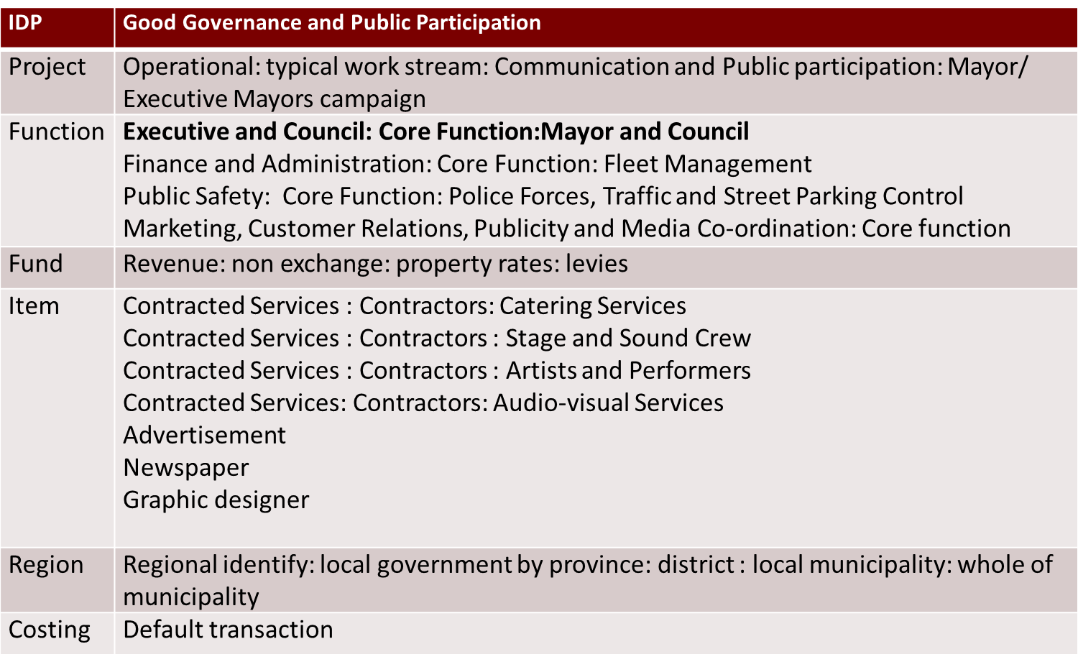
UNPACKING THE IDP
KPA:Good Governance and Public Participation
Project description:
Municipality planning to have a community participation programme on a quarterly basis and the office of the mayor will champion the process and the programme budget is R500 000

Slide 11
Funded Budgets
Funded Budgets: Budgeted Expenditure must be based on Budgeted Available Funds
The funded budget concept requires for municipalities to budget on Revenue including Transfers and grants.
Historic information and futuristic planning will inform the cash flow statement which gives rise to the available funds to be spent for the budgeting period.
As a suggestion, municipalities should initially budget on Revenue, to identify the funds available for budgeting.

Slide 12
Funded Budgets
Example continued from slides 6 & 7 …
Project Segment- Capital: Infrastructure: New: Roads Infrastructure: Roads: Ward 6 – Roads
Function: Road Transport: Core Function: Roads
Assets:Non-current Assets: Property Plant and Equipment: Cost Model: Roads Infrastructure: Cost:Acquisitions
Fund:Capital:Transfers and Subsidies:Monetary Allocations:Provincial Government:Western Cape:Housing:Human Settlement Development
Regional: Regional Identifier: Local Government by Province: Western Cape: District Municipalities: DC01 West Coast: Municipalities: WC014 Saldanha Bay: Ward: Ward 6 Langebaan/Farms
Costing: Default

Slide 13
Balance Sheet Budgeting
The accounting Double entry of the income/expenditure budget will populate the relevant movement accounts in the balance sheet items.
The Opening balance and the movement accounts will consolidate into the closing balance of the balance sheet items.
Dr - Assets:Non-current Assets: Property Plant and Equipment: Cost Model: Roads Infrastructure: Cost:Acquisitions
Cr - Assets:Current Assets:Cash and Cash Equivalents:Cash at Bank:Bank Account: Absa

Slide 14
Balance Sheet Budgeting
Cash Flow Statement Budgeting
All General Revenue will be budgeted against the Debtors Control. Municipalities will also budget for all expenditure against the Bank Account.
The budgeting process then warrants for both retrospective and progressive planning which will inform the portion of debt that can be budgeted as cash based items. Likewise, the portion of cash based expenditure can be budgeted for as liabilities.

Slide 15
Balance Sheet Budgeting
Example: Municipality budgets for raising Electricity revenue to the value of R 10 000 000. The municipality also projects for a 90% collection rate based on historic trends and measures put in place to enhance debt recovery.

Slide 16
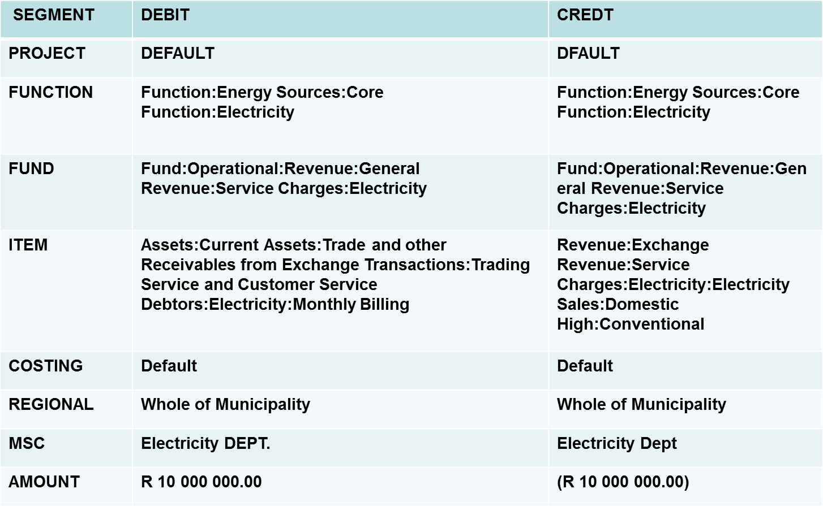
Balance Sheet Budgeting
Example:

Slide 17
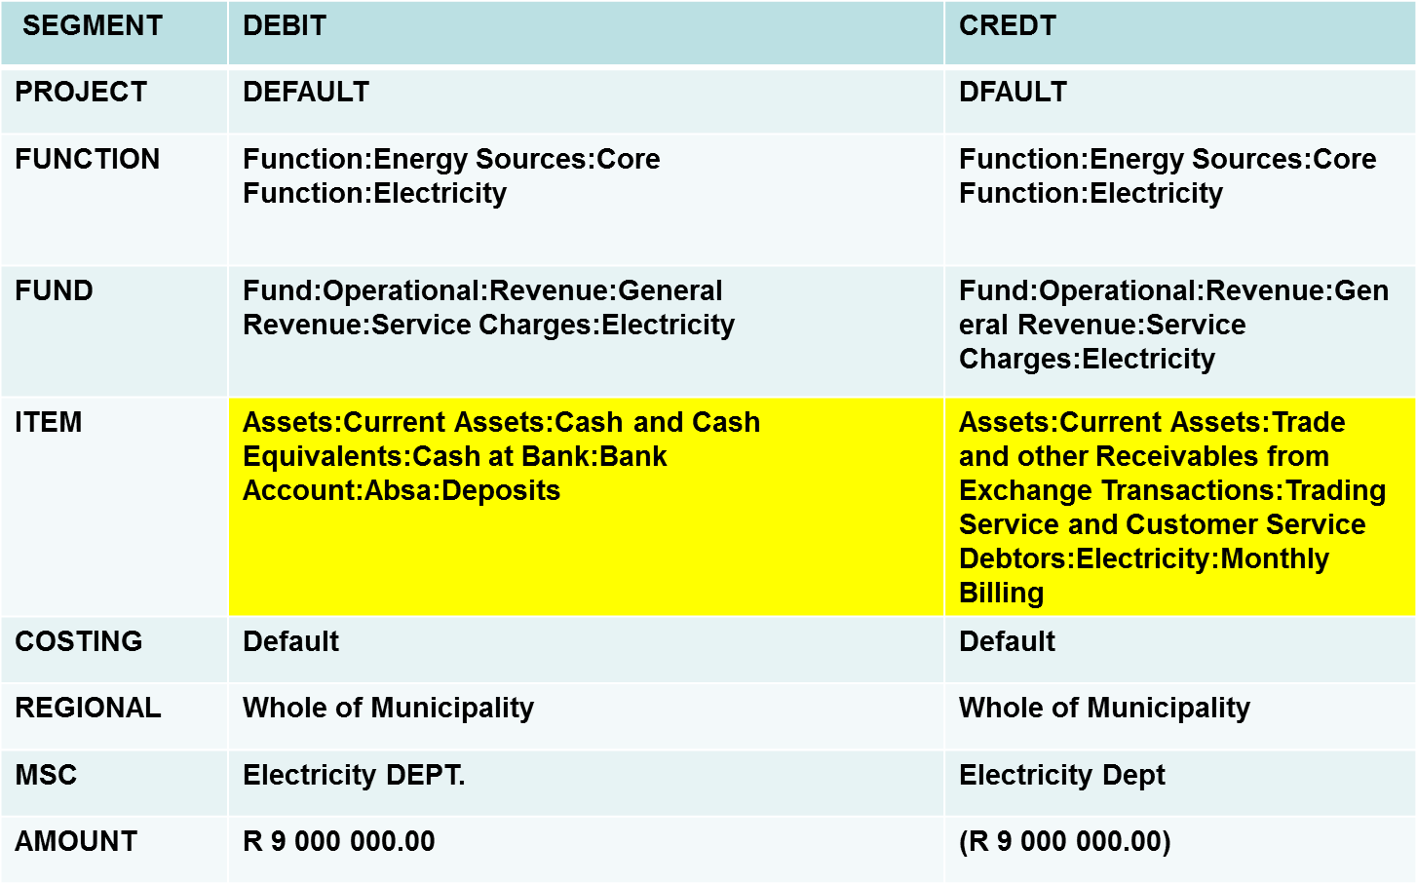
Balance Sheet Budgeting
Example:

Slide 18
MBRR and segments Linking
Project segment linked to A1, A5, A9, SA 34b, SA 36, SA 37 and CAA
Function SA36
Fund to A1
Region SA36
Costing not applicable
Item to all schedules from A1 to 10 and SA1 to SA 37 inclusive of all IYR

Slide 19
Budgeting
Schedules:
After the completion of the budgeting process, the municipality will be in a position to extract the schedules from the core financial system.
These schedules can be tabled with council as the draft budget .
The municipality must thereafter submit their budget datastring to National Treasury using the Lgportal.

Slide 20
mSCOA – Data String
Important Data String Format : The file MUST be a .TXT file. There is no naming convention for the file.
No Headings allowed
No Decimals allowed
Guids: Lower case
Period must include: ITY1 ITY2 TABB TM01 TM02 TM03 TM04 TM05 TM06 TM07 TM08 TM09 TM10 TM11 TM12

Slide 21
QUESTIONS?

